Slide 1
Welcome
Welcome to the 2022 online Telecommunications Workshop – we will start on time
Meanwhile, un-mute your microphone, turn your camera on and say hello to the rest of the group
If you have any problems please call, text, or Email the course facilitator, (insert name) at 555.555.1212 or email@isp.com
If you lose connectivity during the session, we suggest you restart your computer before re-entering the session
Notes:
For online presentations, use this slide as the “waiting” screen as members “sign in.”
Enter your specific information (name, phone number and email) in the third bullet
If this is done in a classroom setting you can skip this slide.

Slide 2
Telecommunications Workshop
2022
Telecommunications Division
Response Directorate

Slide 3

Auxiliary Telecommunications

Slide 4
Welcome
This workshop will:
Discuss how Risk Management relates to Communications
Highlight policies and procedures in practical Operations
Review current communications programs and missions
Discuss experiences in Communications and look for improvement
Notes:
Instructors/Presenters - Do not just read the slide and/or the speakers notes. Get some participation from the group you are presenting to. This will provide maximum benefit to the members.

Slide 5

Ground Rules
This workshop is interactive, and should not be a Lecture
  Ask Questions
  Answer Questions
  Share Experiences
  Share Insights
  A summary of opinions and feedback should be passed up the Chain of Leadership/Management.
Participate - Participate - Participate

Slide 6
Risk Management
2022 Risk Management Discussion
Notes:
Remind the group - In all Auxiliary operational activities Risk Management is a necessary part of the operation and must be performed THROUGHOUT the operation jot just at the beginning. You will see this reminder throughout the presentation because it is that important.

Slide 7
What Do You Need to Do?
Within Communications, all Elected Officers, Response Directorate, CM officers, Telecommunications Operator (TCO) and Communications Watch Stander (CWS) are required to take immediately and maintain RM/TCT training.
Complete the Introduction to Risk Management training course on AUXLMS, course 100202
  This is a one-time training requirement to introduce the principals of RM and the critical human factors skills
  Annually complete TCT refresher class

Slide 8
What is Risk Management
A continuous, systematic, process of identifying and controlling risk in all activities, according to a set of pre-conceived parameters, by applying appropriate management policies and procedures.
This process includes detecting hazards, assessing risk, and implementing and monitoring risk controls to support effective, risk-based decision-making.
Notes:
Note the word CONTINUOUS. Risk Management must be done throughout the mission not just at the beginning for a GAR score, and just for Surface or Air operations.
The old “you have to go out you don’t have to come back” you may have heard about is no longer acceptable. You do NOT have to go out and you DO have to come back and come back safely

Slide 9
Risk Management
The Risk Management (RM) Instruction includes:
  A 5-step process
  The PEACE and STAAR models
  Risk Assessment Matrix (RAM)
  Mandates the use of GAR 2.0
  Standardizes RM training for all communities (surface, air, shore)
Notes:
Be prepared to BRIEFLY comment on what PEACE and STAAR stand for:
Planning
Event Complexity
Asset Selection
Communications
Environment
Spread out
Transfer
Avoid
Accept
Reduce

Slide 10
Risk Management- cont.
Coast Guard (including Auxiliary) operations are inherently complex, dynamic, potentially dangerous, and, by nature, involve the acceptance of some level of risk
Risk Management is more than a form or a process
  It is a mindset and awareness of risk and reward that can be used not only in your Auxiliary life but in everything that we do
Notes:
Even seemingly simple straight forward operations must still go through a Risk Management process. If you do it for the small things you will automatically remember to do it for the large ones. For these ‘simple’ operations start with the question “what could go wrong”, if that does go wrong what will the team do.

Slide 11
Risk Management for Communicators
As Auxiliary Communicators, how do we use RM?
While standing a radio watch, can you help detect hazards, assess risk, and implement and monitor risk controls to support effective, risk-based decision-making?
Remember that you are a member of the same team as those you may be supporting.
Notes:
Discuss with the group – How do they deal with issues in the second paragraph?

Slide 12
Risk Management As A Way Of Life
We continually make decisions based on how much risk we are willing to accept in personal life and in the Auxiliary
By increasing our understanding of Risk and Risk Management, we will increase our performance and safety

Slide 13
Risk Management As A Way Of Life – cont.
We Take Steps To Mitigate The Risks
  Ask for Help
  Modify Our Plans
    Change Our Start Time
    Change Our Equipment
  Check Our Equipment
Notes:
Remember you can not eliminate all risks, but you can always take steps to reduce the risk. If you cannot reduce the risk to an acceptable level, cancel the mission.
Ask the team for a couple other risks that might occur going into a Telecommunications mission and what they could do to reduce that risk. Actual examples of real situations from the group would be even better.

Slide 14
Providing First Aid - CPR
From AUXILIARY OPERATIONS POLICY MANUAL COMDTINST M16798.3E:
E.10. Emergency
Medical Response
NOTE
First aid training (beyond a basic awareness of emergency situations) is not a part of the Auxiliary boat or air crew or radio operator qualification process. Auxiliarists, while on orders (verbal or written) or while assigned to duty, can give first aid. In cases of boating emergencies, Auxiliarists shall advise the unit commander of any emergency medical situation. If unable to contact the unit commander, then seek guidance from competent medical authority.
The Auxiliarist may only provide first aid that they are trained to give and which is within the scope of their assigned duties. For example, an Auxiliarist on an authorized patrol who is not CPR, qualified must not perform CPR but an Auxiliarist who is CPR qualified may..
Notes:
Have the class read the regulation.
If we read this, we see “First aid training (beyond a basic awareness of emergency situations) is not a part of the Auxiliary boat or air crew qualification process” and we “may only provide first aid they are trained to give” .

Slide 15
Mishap Reporting
ALL mishaps must be reported to the Order Issuing Authority (OIA) immediately
  A Coast Guard mishap is defined as any unplanned, unexpected or undesirable event that causes injury, occupational illness, death, material loss or damage.
  The Auxiliary wants any incident which causes a disruption or alteration of the mission reported.
  This allows the mishap to become an education opportunity to be shared across the entire organization.
Mishap reporting does not equal disciplinary action
  This does not apply for flagrant disregard of the rules or reckless or foolhardy actions.
  Incidents occur
  Not reporting a mishap may lead to disciplinary action
Notes:
Per COMDTINST_M5100.47.pdf - a Mishap is “An unplanned, unexpected, or undesirable event or series of events resulting in death, injury, occupational illness, or damage to or loss of materiel. “
Need to define MISHAP. DISCUSS. Anything causing an unplanned stop besides a comfort stop is potentially reportable. Certainly, any mechanical or maintenance issue, but people should use common sense in what they report. Anything that you expect to be reimbursed for should be reported. It is better to over report than under report. Nobody will be criticized for reporting too much. When in doubt report it.
Operations Policy Manual requires those with firsthand knowledge of a mishap to report it. Let’s talk about that.
If you are confident that the principal parties are reporting to the organization, redundant reporting is not needed unless requested.
Why are they requesting that all mishaps; with or without injuries and even if there is no damage be reported?
Whenever a mishap occurs, even with no real damage or injury, is reported this information can be used to aid other members of potential risks and how this risk can be avoided.
This information you provided can be used as a learning or teaching event that can help all of us to become safer.

Slide 16
Policies & Procedures
2022 Policy and Procedures Overview

Slide 17
Communications Governance
AUX Operations Policy Manual (COMDTINST M16798.3 Series)
Telecommunications Manual (COMDTINST M2000.3 Series)
Radio Telephone Handbook – Tactics, Techniques, and Procedures (CGTTP 6-01.1 Series)
Auxiliary Communications Program, Standard Operating Procedure, 21 March 2016
Notes:
Primary guidance is the Auxiliary Operations Policy Manual
As radio operators, we are expected to follow the procedures and policies in the Radio Telephone Handbook and Telecomm Manual

Slide 18
Concept Of Operations
CONCEPT OF OPERATIONS – CONOPS
  Auxiliary Communications Program – Standard Operating Procedures released on 21 March 2016, provides a foundation for the growth and development of current Auxiliary communications capabilities - while conveying to the US Coast Guard Auxiliary (CGAUX) and the US Coast Guard (CG), the role, assets, activities, operations, and overall policies of the Auxiliary Communication System (ACS)
  Communication officers at all levels, are responsible for maintaining an accurate radio communications resource availability list. (See: ICS Form 217A CG)
  ACP-SOP and many other helpful forms may be found on the National Auxiliary website. Go to Directorates, select Response from the top pull down menu. Then on the left side of the screen select Regs & Procedures, then Telecommunications Docs.
Notes:
Concept of Operations for Telecommunications - Overall goal is to Maximize our Telecommunications resources in support of CG activities.

Slide 19
Authorized Operation of Radio Facilities
  Auxiliarists may offer their radios to be used as Auxiliary facilities. If accepted, a single facility identification for all radios at the facility (HF and VHF) used in the same service* will be assigned by DIRAUX or keyed from AUXDATA with DIRAUX approval
  DIRAUX must approve facilities and VHF callsigns which may be assigned by District CM Staff
The DVC-RT issues all HF callsigns
* - a repeater or transportable station is an example of a different service from general fixed land VHF and HF

Slide 20
Authorized Operation of Radio Facilities - Cont.
In order to “Offer for Use“ your radio equipment as an Auxiliary Radio Facility or to seek orders or operate as an Auxiliary Radio Operator you must be a “Qualified Auxiliarist”. You must have Telecommunications Operator (TCO) Qualification and have all currency requirements maintained or, be a qualified active-duty Communications Watchstander (CWS).
  Completing AUXCOM prior to 2008-08-01 is also acceptable but TCO is recommended.
Notes:
The facility ID is NOT the call sign of the radios at the station, the Call Signs are separately assigned according to the Ops Policy Manual and by District procedures (see bullet point).

Slide 21
Authorized Operation of Radio Facilities - Cont.
Only Auxiliary communications staff, elected officers or an OIA may activate Auxiliary radio facilities under one or more of the following conditions:
(Discuss – How can each of these pertain to your AOR?)
For a mission ordered or scheduled by the Coast Guard
• When necessary to handle valid distress traffic
• While conducting technical tests to determine a facility’s capability (e.g., facility inspection)
Notes:
This slide talks to a narrow scope of ordered missions.

Slide 22
Authorized Operation of Radio Facilities - Cont.
When necessary to contact a Coast Guard unit to determine if Auxiliary help is required
When conducting net drills
For assisting in time of disasters or national emergencies
When necessary to conduct authorized Auxiliary activities as assigned by appropriate Coast Guard unit, Auxiliary Operational Commanders or Staff officers
Reference: Operations Policy Manual, Annex 4.C.4

Slide 23
Authorized Radio Operators
Complete the TCO PQS and be approved by DIRAUX
Maintain currency in these:
  Mandatory workshops, including communications
  Blood-borne Pathogen training
  Introduction to Risk Management
  Risk Management TCT refresher
  Auxiliary Core Training completed
If currency is not maintained, member will be in REYR or REWK and operations not authorized until current.

Slide 24
Radio Basics
In all radio communications, we are to act as professionals
At no time shall we refer to ethnicity, race, gender, sexual orientation or religious affiliation in radio transmissions
This is a zero-tolerance policy and must be strictly adhered to

Slide 25
Radio Basics - Cont.
It is often not what you say, but how you say it that demonstrates your professionalism
Brevity and accuracy support mission success and safety
Remember, the public and other agencies “hear” you as the voice of the U.S. Coast Guard
Practice and use proper radio procedures to achieve success, safety, and professionalism
  (No “10” codes, no “Over and Out”, no “Roger WILCO”, no “five by five”, etc.)

Slide 26
Radio Basics - Cont.
REMEMBER:
Always listen before transmitting and be sure you are on the correct channel (frequency) and no one else is talking
Professional presentation – Voice of the Coast Guard
Speak slowly, clearly and calmly– Must be understood the first time
Use proper PROWORDS, avoid slang and jargon

Slide 27
Marine Channel 16
Channel 16 is the international emergency/distress and calling channel
Monitor channel 16 whenever able (at least in scan mode) even if there is a specific reason to monitor another channel (regatta, SAR case, guard channel, etc.)
Encourage all boaters to monitor channel 16 when underway

Slide 28
Programs & Missions
2022 Communications
Programs & Missions

Slide 29
Who is in Charge?
DIRAUX
Sectors/Stations
CG5IT
Contingency Commands
Auxiliary Leadership
Notes:
CG COMMCOM is the command responsible for CG HF operations worldwide, and for oversight of Auxiliary HF operations
DIRAUX administers Auxiliary activities overall and the District Commander has responsibility for all operations within the District
Sectors and Stations may issue orders for specific operations
CG5IT has responsibility for all CG Communications and IT
Contingency Commands may take overall command of areas during contingent operations
Auxiliary Leadership, both elected and appointed staff have responsibility to manage Auxiliary activities

Slide 30
Communications Operations
VHF Radio Guard for AUX Vessels and Aircraft
Watch Standing at Coast Guard Stations and Facilities
HF Programs
  HF Contingency Nets
  HF Monitoring (AUXMON)
  Communications Augmentation (AUGCOM)
  SHARES
Rescue 21 Contingency Support
District and Sector Activities
AUXSCOUT Program
AUX VHF Operations – Our own space – used for?
Notes:
What do we do as as Telecommunications Operators?
SHARES – A DHS administered radio program coordinating a voluntary network of government, industry, and disaster response agency HF radio stations used for emergency communications

Slide 31
VHF Communications
7 CG Auxiliary VHF frequencies are available for our use on radios with maximum allowed output power of 50 watts. (AUXNET) Work is being done to standardize these channels nationally.
  Administrative support
  Command and Control
  Repeater – wide-area Auxiliary coordination
  Training
  Use away from the water ways
VHF repeaters are allowed an output power of 100 watts
Maximum output power on channels in the “Marine band” is 25 watts
No power amplifiers allowed on VHF radios
Cannot be “modified” amateur radios
Notes:
These frequencies are in the 136-174 MHz frequency range., excluding the 2-Meter. Amateur band, 144-148 MHz.
Encrypted radios may be loaned on an as needed basis and returned following the activity.

Slide 32
VHF Communications - Cont.
RDF (Radio Direction Finding) stations are authorized
VHF handheld marine radios MAY be accepted as mobile facilities in special cases
APRS (Automatic Packet Reporting System) is not authorized
MMSI (Maritime Mobile Service Identity) numbers are not authorized for Auxiliary aircraft but can be registered to surface facilities.

Slide 33
VHF Repeaters
There are 56 Auxiliary VHF repeaters currently throughout the United States, most of which share common input/output frequencies, with varied Continuous Tone-Coded Squelch System (CTCSS) tone access. Most are unit owned. A national plan, for uniformity and interoperability across Districts, is in its final phase.
Repeater requests (CG Form 6086) must be reviewed by CG Office of Spectrum Management before construction or implementation
Maximum output power of 100 watts
Frequencies must match the National Channel Plan

Slide 34
CG Station Radio Watchstanding
Auxiliary Watchstanders at a CG station must complete the same training as active-duty CG watchstanders and stand a “board examination”
  They must have received, or applied for, DO security clearance prior to being certified as a CG Watchstander
  Watchstanders serve at the Station CO’s discretion
AUXCOM or TCO/PQS are helpful and might be required at the discretion of the station CO/OIC

Slide 35
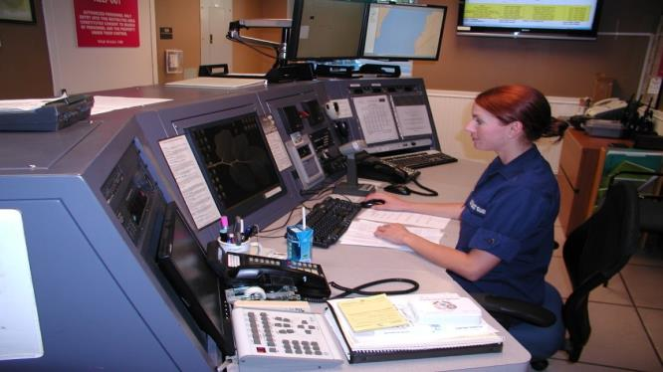
Coast Guard Watch Standing
The US Coast Guard has asked for Auxiliary members to become Coast Guard Communications Watchstanders (CWS).
What does a CG CWS do?
Common activities include:
Monitor and answer the radios and phones
Stand Guard for underway unit assets
Keep radio logs and document SAR cases
Give unit internal announcements - “Pipes”
Assist and keep informed the unit command structure
And more…
Notes:
Members that completed AUXCOM prior to August 1, 2008 are authorized the same watchstander privileges and authority as TCO qualified members, but it is highly recommended that AUXCOM members also become TCO qualified to refresh their skills and knowledge of procedures
AUXCOM/TCO may not be required by the Coast Guard CO/OINC but is still highly recommended and will make passing the PQS for Coast Guard easier.

Slide 36
Watch Standing Requirements
Requirements:
  BQ qualified
  Passed TCO or AUXCOM prior to 8/1/2008 (varies per District)
  Current with AUXCT
  Taken ICS 100, 200, 700, 800
  DO Security clearance for CG Watchstander position
Next steps:
  Request approval through FSO-CM to your FC
    CM/FC requests approval through Auxiliary Coordinator
Notes:
Members that completed AUXCOM prior to August 1, 2008 are authorized the same watchstander privileges and authority as TCO qualified members, but it is highly recommended that AUXCOM members also become TCO qualified to refresh their skills and knowledge of procedures
AUXCOM/TCO may not be required by the Coast Guard CO/OINC but is still highly recommended and will make passing the PQS for Coast Guard easier.

Slide 37
Watch Standing Recruitment
You are interested in becoming a CWS and helping a CG Unit. What do you do?
I am interested
Inform your Chain of Leadership
Decide on a C.G. Unit to assist
Begin training at the C.G. Unit
Complete Sign-offs and pass an Oral Board
Start Dispatching

Slide 38
Auxiliary Station Watchstander
Watchstanders at an Auxiliary Communications unit (ACU) must be certified as TCO or completed AUXCOM prior to August 1, 2008
  Must be TCO certified if the chief operator in a multiple-operator situation. Other operators must be under the supervision of the TCO.
  Other requirements might be required, on a District-by-District basis
  A radio watch requires that the station is actively manned, and the operator is ready for intervention
Notes:
ACU can be unit-owned or be a personal facility at home or in a vehicle, or other authorized facility

Slide 39
Vessel & Aircraft Guard
Auxiliary Communications Units (ACUs) may be authorized by CG OIA to provide radio guard for AUX vessels and aircraft
  ACUs may provide guard CG vessels when directed by an OIA.
All AUX vessels and aircraft must maintain a radio guard with a land station or other designated AUX communications facility.
Vessels under 60 feet – Every 30 minutes*
Fixed wing, multi-engine aircraft – Every 30 minutes*
Single-engine fixed wing and rotary wing aircraft – Every 15 minutes*
Must report status of operations and present geographic location (aircraft may also report fuel status every 30 min)
*unless otherwise assigned by the command

Slide 40
Holding Guard
When assuming “Guard”, you have taken responsibility for continuous monitoring of the vessel, aircraft or activity
Communications schedules with the unit must be maintained
If schedules are missed, a sequence of steps must be initiated to re-establish comms and determine condition of the monitored unit
OIAs must be notified when comms are lost for a pre-determined period
When standing watch for an asset, be sure that you have a clear understanding of the role you play, between them and the Order Issuing Authority (OIA) or command authority. Always be prepared to be proactive in Risk Management for yourself and the asset that's underway

Slide 41
Radio Communications Procedure-1
As a watchstander at an Auxiliary radio station you receive a request to assist a civilian boater with getting a weather report for storms in the area. What do you do?
  Tell them to tune their radio to a weather station
  Tell them you are not a qualified weather observer
  Tell them what the National Weather Service predicts or what you have seen or heard on the weather channels
Notes:
DISCUSS EACH
SEE THE TCO PQS FOR DETAILS

Slide 42
Radio Communications Procedure-2
As a watchstander at an Auxiliary radio station you receive a request for assistance with a disabled vessel. What do you do?
  Ask if they are a subscriber of a Commercial Towing Company
  Report the disabled to the CG Station /Sector
If Station/Sector okays it, then:
  Tell them you can put out a Marine Assistance Radio Broadcast (MARB)
  Relay the call to an Auxiliary boat in the area
  Other?
Notes:
DISCUSS EACH
MARB – Marine Assistance Radio Broadcast
SEE THE TCO PQS FOR DETAILS
Standard Response to a Request for Vessel Assistance If Determined To Be a Non-Distress Step Action
1 “For the situation you've described, Coast Guard guidelines require that we attempt to locate other capable and timely help for you. Is there a friend, marina, or commercial firm that you want us to contact for you? OVER”
2 (If affirmative, contact the party as requested. If negative, then continue with):
3 “We can make a Marine Assistance Request Broadcast on your behalf. This announces that you need help, gives your location, and invites others to come to your aid. Do you want us to make a broadcast for you? OVER”
4 (If affirmative, complete a broadcast. If negative, then respond with):
5 “ROGER, PLEASE ADVISE US IF YOUR SITUATION CHANGES, OR IF YOU CHANGE YOUR MIND CONCERNING THE MARINE ASSISTANCE REQUEST BROADCAST. THANK YOU, COAST GUARD AUXILIARY (UNIT) __________ STANDING BY, OUT”

Slide 43
Radio Communications Procedure-3
As a watchstander at an Auxiliary radio station you receive a MAYDAY call. What do you do?
  Get their location
  Get a count of number of persons aboard and description of vessel
  Get all details on nature of their distress
  Inform the CG station/sector if they have not heard the call.
  Relay the call to rescue facilities (CG / Auxiliary / law enforcement / commercial salvors /others) in the area
  Maintain comms with distressed vessel
  Maintain control of comms until relieved
  Other?
Notes:
DISCUSS EACH
Why do you get location first?
SEE the USCG Addendum to the US SAR Manual
SEE THE TCO PQS FOR DETAILS:
Standard Script for Watchstander to Follow When Taking Assistance Information The following script is provided as a training scenario but must be committed to memory, and a SAR check sheet from the Addendum to the National SAR Manual must be readily available. After determining that Coast Guard assistance is being requested and the name and time of notification has been recorded, use the following script to request assistance information:
Step Action
1 “Vessel in distress (or vessel name), __________, this is Coast Guard Auxiliary (unit) __________.”
2 “What is your position?” __________“How many people are on board your vessel?” __________
3 “What is the nature of the situation?”(unless already given)
4 “What is the description of your vessel?” __________
5 “Put on life jackets, if you haven’t already.”
6 “Any medical situations on board?” __________
7 “What attempts have you taken to control the situation?”
8 “Estimate wind and waves.” __________
9 Check with (Officer of the Deck) OOD/command cadre on proper response to situation.

Slide 44
High Frequency (HF) Communications
HF serves as a platform for several missions:
  HF Voice and Data Contingency Nets
  AUXMON (Auxiliary Monitoring Mission) A quality control program for Coast Guard broadcasts
  AUGCOM Global Maritime Distress and Safety System (GMDSS) monitoring for digital and SSB voice distress calls (replaces the old SSB voice distress calls)
  SHARES – A DHS administered radio program coordinating a voluntary network of government, industry, and disaster response agency HF radio stations used for emergency communications
Notes:
AUGCOM is augmenting of Coast Guard Communication systems.
GMDSS – Global Maritime Distress frequencies

Slide 45
HF Communications – Radio Facilities
Maximum power output 1000 watts on HF radios
Usable for Auxiliary HF radio Nets
41 frequencies 2-23 MHz are available
Radios must be able to transmit outside of Amateur bands
Accommodates digital modes
Supports CG contingencies and SHARES
Radios must meet NTIA (National Telecommunications & Information Administration) standards
Notes:
Radios used for HF operations must meet NTIA (National Telecommunications and Information Agency) standards for stability, purity and capabilities of output.

Slide 46
HF Contingency Nets
Many districts have established contingency nets of HF stations.
Contingency nets are requested by districts or regions and coordinated through BC-RTC for approval by DVC-RT in coordination with CG Communications Command (COMMCOM)
All nets provide contingency voice communications
Many nets have capability to send digital message traffic
Nets work closely with SHARES for regional operations
Most nets practice on a schedule
Net may be activated by DSO-CM on direction from the District or National Auxiliary chain, or from contingent commands.
Notes:
COMMCOM – responsible for all HF worldwide communications for the Coast Guard

Slide 47
AUXMON
AUXMON stations monitor CG broadcasts to mariners on stations located on the East Coast, Gulf Coast and Pacific Coast
The Coast Guard broadcasts are by HF voice, digital, and FAX
Members monitor and report any problems to Communications Command (COMMCOM)
HF radio equipment and special software is required to participate in the AUXMON program
Additional AUXMON members are needed
For application, please see: http://rdept.cgaux.org/documents/Comms/AUXMONApplicationrs.pdf

Slide 48
AUGCOM MISSION
Directly supports the CG COMMCOM, Sectors and other CG Commands
Provide active and passive monitoring of HF voice and DSC message traffic when potential outages of Coast Guard COMSTAs could occur.
Aids response to GMDSS HF maritime services for sea area A-2
Participants are a select group of qualified Auxiliary HF facilities and designated as Communications Augmentation Station (AUGCOMSTA)
Requires marine sideband equipment and software to monitor DSC messages.
Activated on specific orders from COMMCOM through National Telecomm Staff

Slide 49
SHARES (Shared Resources)
Administered by Department of Homeland Security (DHS)
This program provides the Federal emergency response community with a single interagency emergency message handling and frequency spectrum management system
SHARES promotes interoperability between HF radio systems used by Federal departments and agencies and monitors applicable regulatory, procedural, and technical issues
Auxiliary stations may be part of the SHARES network. Check the information on the Telecommunications National Web site
Notes:
The Telecoms website is at http://wow.uscgaux.info/content.php?unit=R-DEPT&category=communications

Slide 50
Rescue 21 Contingency Support
Rescue 21 is the computer-based search and rescue and command and control system used by the Coast Guard active-duty stations
Rescue 21 is highly reliable but may suffer outages if the remote facilities are damaged or out of service
The Auxiliary has partnered with Coast Guard commands to provide contingency coverage for Rescue 21 outages (varies by district and sector)

Slide 51
Rescue 21 Contingency Support - cont.
CG OIAs activate selected Auxiliary fixed and transportable facilities to cover gaps in coverage during R21 outages
AUX stations provide nominal monitoring out to 15 or more nautical miles where practical
Activated Auxiliary Communications Units (ACUs) hearing distress or urgency traffic without CG response report traffic to designated SAR controller.
Receiving Auxiliary units respond only upon direction of the CG command

Slide 52
Auxiliary Radio Facilities
2022 Communications
Facility Descriptions and Requirements

Slide 53
What Is A Facility?
A radio station that is offered for use of the Coast Guard by an Auxiliary member is called a radio facility. These may be:
  Fixed land station installed in a building
  Land mobile station installed in a vehicle
  Transportable station that can be taken from place to place, but not used until set up
  at a final location
  Repeater unattended base station that automatically repeats lower-powered mobiles
  and portables from its higher location with higher power
  Portable station that can operate from battery power while hand carried
Notes:
Fixed Land is a radio station at a fixed location, no matter the number of radios operated within it.
Land Mobile is a radio station operated from a vehicle, whether stationary or moving
Transportable is a radio station that is intended to move from place to place, operated once it is set up a a location, but not operated in motion
Repeater is a radio station at a fixed location intended to automatically simultaneously repeat transmissions from input to output frequency
Portable is a handheld radio, usually intended for local communications or for use through a repeater

Slide 54
Facility Acceptance
To be accepted and certified as a facility, there are several steps that must be completed:
  Enter the radio details on a 7004 Form, or directly to AUXDATA
  Ensure those details are entered into AUXDATA on a facility input page
  Submit the facility for inspection to a certified Radio Inspector
  Pass the inspection and submit to DSO-CM
  Inspector approves and forward to DIRAUX for approval
Next slide illustrates this process

Slide 55
Facility Approval Flow
Facility application
AUXDATA II File
Member applies for inspection
DSO-CM verifies
OTO/DIRAUX approve
1
2
3
4
5
Notes:
Work through the flow diagram with the participants

Slide 56
Facility Inspection
Radio stations must be inspected to be accepted as facilities
  Facility inspectors must be:
    Current National, District, Division or Flotilla communications staff officers
    Current TCO-qualified or AUXCOM prior to 01/08/2008.
    Or, TCO-qualified and assigned by DIRAUX as an inspector

Slide 57
Facility Inspection Requirements
Inspectors must check all equipment in a station used for Auxiliary communications for safety and functional operation.
Inspectors should check for:
  Ability to receive and transmit on Auxiliary frequencies
  Appropriate antenna connections
  Proper equipment grounding
  Maintenance of logbooks

Slide 58
Facility Detail
DIRAUX may assign each asset, whether a vessel, aircraft or radio, a facility identification number (OPFAC #) e.g., For radios: NMxxx or NFxxx.
AUXDATA II automatically assigns a Facility Record Number. (e.g., F-xxxxx)
These identification numbers are for record keeping and searching only and are not a call sign.
The facility identification/record number are entered when required in AUXDATA II forms

Slide 59
Facility Call Sign Issuance
DIRAUX approves VHF radio callsigns, which may be assigned by DIRAUX or the District CM Staff
  E.g., “Auxiliary Boston Radio”, where Boston signifies the geographic location. (See Auxiliary Operations Policy Manual (AOPM) for details)
  DIRAUX does not issue Auxiliary HF callsigns
Facility owners with both VHF and HF radios to submit must check both the VHF and HF/MF-SSB boxes and enter all radio information into AUXDATA II for submission through the chain for issuance of their HF callsign

Slide 60
Facility Call Signs
VHF call signs
  Fixed land stations - geographic location of the station (e.g., Auxiliary Kingston Radio). For several stations in Kingston, the next one is Auxiliary Kingston 2 Radio.
  Mobile stations - either the flotilla name followed by an alphanumeric (e.g., Auxiliary Miami Mobile 1) or a district numbering scheme such as Auxiliary Mobile 10-13 D.
HF call signs
  Assigned by National Telecommunications; format Nx##xx, where x is a letter and # is a number.

Slide 61
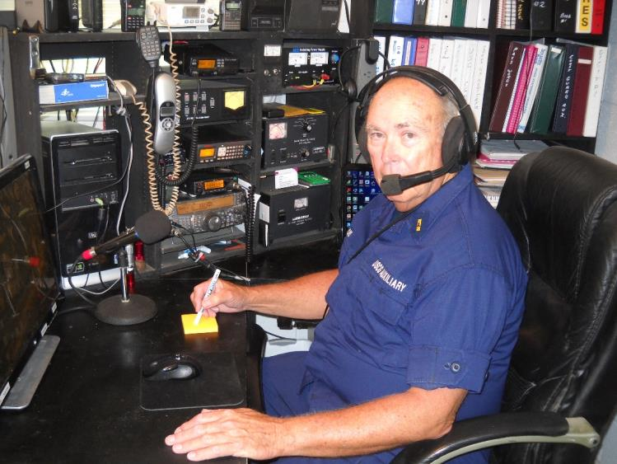
Facility Land Facilities
Fixed land facilities are permanently located in a fixed location either owned by the Auxiliary or in a residence or similar building, owned by the radio facility Auxiliary owner
The location is FIXED and DIRAUX must authorize relocation of the radio facility via AUXDATA II entry using Form 7004 as a worksheet
Approved radio facilities may be referred to as an ACU

Slide 62
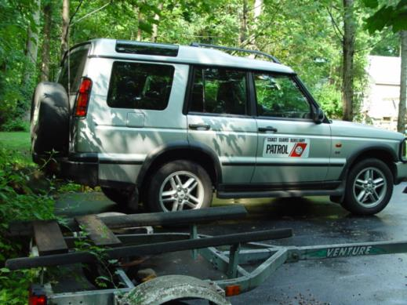
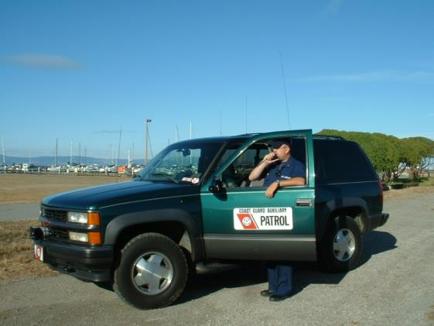
Mobile Radio Facilities
Mobile radio facilities are usually mounted in vehicles and can be used while the vehicle is in motion
Movement at the direction of the CG requires orders, usually via the AUXDATA II process
They are not to be confused with TRANSPORTABLE radio facilities

Slide 63
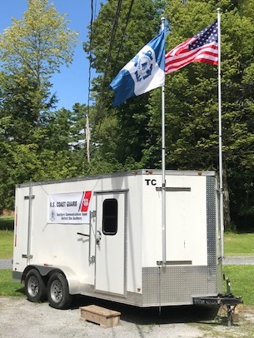
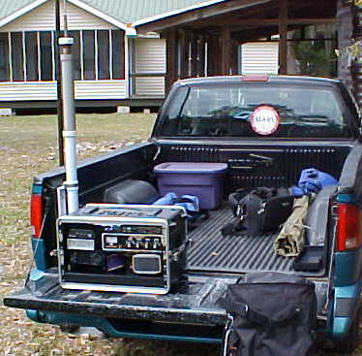
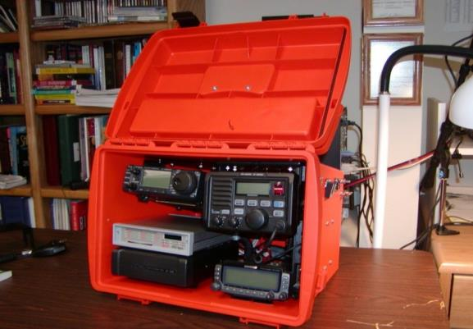
Transportable Radio Facilities
  A station which is transferred to various fixed locations but is not intended to be used while in motion. Examples are “go-kits” and trailers.
A transportable station should always be ready for emergency deployment, but is not used on a regular basis and is not used at a permanent location
Notes:
A transportable station is normally configured to permit it to be easily transported and set up for operation in various temporary locations
A transportable station should always be ready for emergency deployment, but is not used on a regular basis and is not used at a permanent location
Movement at the direction of the CG requires orders via the AUXDATA II process

Slide 64
Operations Under Orders
Orders should be requested from an OIA when:
  A radio facility is “holding guard” for, or communicating with, Auxiliary or Coast Guard facilities operating under orders
  A radio facility or operator is being deployed to another location
Orders may be issued via AUXDATA, verbally, or by mail or email, pending written follow-up

Slide 65
OIA Considerations
When a Mobile Radio Facility is directed to move, orders are required. A Coast Guard OIA (order issuing authority) approves orders using AUXDATA II.
  Orders may be issued verbally or by email, pending written follow-up
  Auxiliary mobiles during their normal activities may operate when assigned to duty by applicable Auxiliary officers
When a Transportable Radio Facility is directed to move DIRAUX approval is required
  In those situations where an operator (TCO), under orders, travels from home to arrive at a Fixed Land ACU, they are not eligible for travel reimbursement. Depending on their ACU duty hours, relative to mealtime, they may request reimbursement for meals through the AUXDATA process

Slide 66
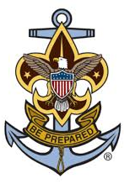
AUXSCOUT
Auxiliary-Sea Scout Youth Development Program
When involved with Sea Scouts observe all provisions of the current SOP
Notes:
The Auxiliary and the Sea Scouts identified several benefits to enhancing their partnership including improved Sea Scout training opportunities, enriched Coast Guard and Auxiliary recruiting, and better overall promotion of recreational boating safety among our Nation’s boating public.
There are specific requirements when working with Sea Scouts that need to be followed:
Consent Forms
Required training specified training as defined in the SOP
Limitations in participation in SAR activities
Qualifications open to sea scouts
Refer to the current Sea Scout SOP for requirements and details

Slide 67

National Contact Information
Chief, Telecommunication Division
COMO David Elliot, DVC-RT
David.Elliot@cgauxnet.us
772-781-5969
Contingency Communications
David Rockwell, BC-RTC
David.Rockwell@cgauxnet.us
727-823-7580
Program Integration
Don Wellons, BC-RTI
Donald.Wellons@cgauxnet.us
912-266-4041
Coast Guard Support
Andy Ely, BC-RTS
Andrew.W.Ely@coastguardaux.us
732-390-9300
Qualification and Training
Aaron Forste, BC-RTQ
Aaron.Forste@cgauxnet.us
201-315-6770

Slide 68
References
For additional information on Telecommunications, please check the references available on the National Web Site Telecommunications area
Some documents contain PII or sensitive information and require a password that may be obtained from your DSO-CM
AUXMON Methods & Procedures
AUXMON Methods & Procedures Annex 1
AUXMON Station Application
AUXMON 7030 Mission Report Format
Auxiliary Radio Net Schedules
HF Frequencies
HF Registry
HF Contingency Net Plan Document
Repeater Registry
AUXMON Registry (PDF)
Auxiliary VHF Frequencies

Slide 69
Responder Articles
The Response Directorate is always looking for articles for The Responder
Submit articles To DVC-RT (David.Elliot@cgauxnet.us)

Slide 70
Operations Workshop Debrief
What went right with today’s workshop?
What went wrong with today’s workshop?
What could be done better next time?

Slide 71

Thank You For Your Participation
Any additional feedback on the content of this presentation may be sent to:
Division Chief – Education
Bruce Pugh - DVC-RE
        Roy Savoca DIR-R
        Sue Thurlow DIR-Rd
        David Elliot DVC-RT

