Slide 1
2019 Telecommunications Workshop

Slide 2
Auxiliary Telecommunications
2

Slide 3
Welcome
This workshop will:
Present Risk Management
Review existing policies and procedures
Review current communications programs and missions
Preview new programs, procedures, and missions
This is an optional workshop, but it may be “required” at the local level for all Telecommunications Operators (TCO)
3

Slide 4
Ground Rules
This workshop should be interactive, NOT a Lecture
Ask Questions
Answer Questions
Share Experiences
Share Insights
Participate – Participate - Participate

Slide 5
Risk Management
2019 Risk Management Discussion
5

Slide 6
Definition of Risk
A Coast Guard mishap is defined as any unplanned, unexpected or undesirable event that causes injury, occupational illness, death, material loss or damage.

Slide 7
What is Risk Management
A continuous, systematic process of identifying and controlling risk in all activities according to a set of pre-conceived parameters by applying appropriate management policies and procedures. This process includes detecting hazards, assessing risk, and implementing and monitoring risk controls to support effective, risk-based decision-making.
7

Slide 8
Risk Management
Risk Management is more than a form or a process.
It is a mindset and awareness of risk and reward that can be used not only in your Auxiliary life but in everything that we do.
8

Slide 9
Risk Management As A Way Of Life
We Continually Make Decisions Based on How Much Risk We Are Willing To Accept
Personal
Auxiliary
By Increasing Our Understanding Of Risk Management – We Will Increase Our Performance and Safety
9

Slide 10
Risk Management As A Way Of Life
We Take Steps To Mitigate The Risks
Ask for Help
Modify Our Plans
Change Our Start Time
Change Our Route
Check Our Equipment
10

Slide 11
Risk Management
Coast Guard (including Auxiliary) operations are inherently complex, dynamic, potentially dangerous, and, by nature, involve the acceptance of some level of risk
Due to these issues the Coast Guard has revamped the Risk Management program, including what we know as TCT
11

Slide 12
Major Changes to RM
The Risk Management Instruction;
Updates the RM process from 7 steps to the new 5 step process
Reintroduces the PEACE and STAAR models
Introduces the Risk Assessment Matrix (RAM)
Mandates the use of GAR 2.0
Standardizes RM training for all communities (surface, air, shore)
12

Slide 13
What You Need to Do
Complete the Introduction to Risk Management training course on AUXLMS, course 100202
This is a one-time training requirement to introduce the principals of RM and the critical human factors skills
13

Slide 14
CONCEPT OF OPERATIONS
CONCEPT OF OPERATIONS – CONOPS - http://rdept.cgaux.org/documents/Comms/AuxiliaryCommunicationsProgramSOP.pdf - was released on 21 March, 2016 for Auxiliary Communications and provides a foundation for the growth and development of current Auxiliary communications capabilities while conveying to the US Coast Guard Auxiliary (CGAUX) and the US Coast Guard (CG), the role, assets, activities, operations and overall policies of the Auxiliary Communication System (ACS)
Communication officers at all levels, are responsible for maintaining an accurate radio communications resource availability list. (See: ICS Form 217A CG)

Slide 15
Authorized Operation of Radio Facilities
Only Auxiliary staff or elected officers may activate Auxiliary radio facilities under one or more of the following conditions:
• For a mission ordered or scheduled by the Coast Guard
• When necessary to handle valid distress traffic
• While conducting technical tests to determine a facility’s capability (e.g., facility inspection)
• When necessary to contact a Coast Guard unit to determine if Auxiliary help is required
15

Slide 16
Authorized Operation of Radio Facilities (con’t)
When conducting net drills
For assisting in time of disasters or national emergencies
• When necessary to conduct authorized Auxiliary activities as assigned by appropriate Auxiliary Operational Commanders or Staff officers
Reference: Operations Policy Manual, Annex 4.C.4
16

Slide 17
Authorized Operation of Radio Facilities (con’t)
“Qualified Auxiliarists” must have completed AUXCOM prior to August 1, 2008 or be TCO (PQS) qualified
Auxiliarists may offer their radios to be used as Auxiliary facilities. If accepted, a single facility identification for all radios at the facility (HF and VHF) used in the same service will be assigned by DIRAUX and the information entered in Auxdata
DIRAUX approves all VHF callsigns which may be assigned by District CM Staff. The DVC-RT issues all HF callsigns
17

Slide 18
Radio Basics
In all radio communications, we are to act as professionals
At no time shall we make reference to ethnicity, race, gender, sexual orientation or religious affiliation in radio transmissions
This is a zero tolerance policy and must be strictly adhered to
18

Slide 19
Radio Basics (con’t)
It is often not what you say, but how you say it that demonstrates your professionalism
Brevity and accuracy supports mission success and safety
Remember, the public and other agencies “hear” you as the voice of the U.S. Coast Guard
Practice and use proper radio procedures to achieve success, safety, and professionalism
No “10” codes, no “Over and Out”, etc.
19

Slide 20
Radio Basics (Cont.)
REMEMBER:
When you key the microphone on your radio “The Whole World is Listening!”
Always listen before transmitting and be sure you are on the correct channel (frequency)
20

Slide 21
VHF Communications
7 CG Auxiliary narrow band VHF frequencies are available for our use on narrow band radios with maximum allowed output power of 50 watts
VHF repeaters are allowed an output power of 100 watts
Maximum output power on channels in the Marine band is 25 watts
No power amplifiers allowed on VHF radios
21
Notes:
These frequencies are in the 136-174 MHz frequency range., excluding the 2 Mtr. Amateur band, 144-148 MHz.
Encrypted radios may be loaned on an as needed basis and returned after the event ends.

Slide 22
VHF Communications (con’t)
RDF (Radio Direction Finding) stations are authorized
VHF hand held marine radios MAY be accepted as mobile facilities in special cases
APRS (Automatic Packet Reporting System) is not authorized
MMSI (Maritime Mobile Service Identity) numbers are not authorized for Auxiliary aircraft
22

Slide 23
VHF REPEATERS
There are 56 Auxiliary VHF repeaters throughout the United States, most of which share common input/output frequencies, with varied CTCSS tone access. Most are unit owned
Repeater requests (CG Form 6086) must be reviewed by CG Office of Spectrum Management before construction or implementation
Maximum output power of 100 watts
Narrowband only
7 possible frequencies
23

Slide 24
HF Communications
HF serves as a platform for other missions:
AUXMON (Auxiliary Monitoring Mission) A quality control program for Coast Guard broadcasts
AUGCOM GMDSS monitoring for digital and SSB voice distress calls (replaces the old SSB voice distress calls) http://rdept.cgaux.org/documents/Comms/AUGCOM/AUGCOM%20Mission%20Final%20to%20BSX%202016_PDF.pdf
SHARES – A DHS administered radio program that coordinates a voluntary network of government, industry, and disaster response agency HF radio stations used for emergency communications
24

Slide 25
HF Communications (con’t)
Maximum power output 1000 watts on HF radios
Usable for Auxiliary HF radio Nets
41 frequencies 2-23 MHz are available
Radios must be able to transmit outside of Amateur bands
Accommodates digital modes
Supports CG contingencies and SHARES
Reference: http://rdept.cgaux.org/documents/BeQualified/BecomingQualifiedAuxiliaryHighFrequencyProgram.pdf
25

Slide 26
Copyright ©2004 Coast Guard Auxiliary Association, Inc.
26
Notes:
HF Net Managers located in OR, Southern CA, NM, Wisconsin, TN, North FLA, Central FLA, PA.

Slide 27
CG Station Radio Watchstanding
Auxiliary Watchstanders at a CG station must complete the same training as active duty CG watchstanders and stand a “board examination”
They must have received, or applied for, DO security clearance prior to being certified as a CG Watchstander
Watchstanders serve at the Station CO’s discretion
AUXCOM or TCO/PQS are helpful and might be required at the discretion of the station OIC
27

Slide 28
Auxiliary Station Watchstander
Watchstanders at an Auxiliary Communications Unit (ACU) must be certified as TCO or completed AUXCOM prior to August 1, 2008
Other requirements might be required, on a District to District basis
A radio watch requires that the station is actively manned and the operator is ready for intervention
28

Slide 29
SHARES (Shared Resources)
Administered by DHS
This program provides the Federal emergency response community with a single interagency emergency message handling and frequency spectrum management system
SHARES promotes interoperability between HF radio systems used by Federal departments and agencies and monitors applicable regulatory, procedural, and technical issues

Slide 30
SHARES (con’t)
Only use the Auxiliary furnished application, Form 1, available only from DVC-RT
Do not use SHARES furnished application
Use Auxiliary HF call sign when logging into a SHARES net
The DVC-RT acts as a facilitator of the application process
See: http://www.dhs.gov/shares
30

Slide 31
AUXMON
AUXMON stations monitor CG broadcasts to mariners on stations located on the East Coast, Gulf Coast and Pacific Coast
The Coast Guard broadcasts are by voice, digital, and FAX all on HF marine frequencies
Members monitor and report any problems to the CG Communications Command (CommCom)
31

Slide 32
AUXMON (Con’t)
HF radio equipment and special software is required to participate in the AUXMON program
Additional AUXMON members are needed
For application, please see:
http://rdept.cgaux.org/documents/Comms/AUXMONApplicationrs.pdf
32

Slide 33
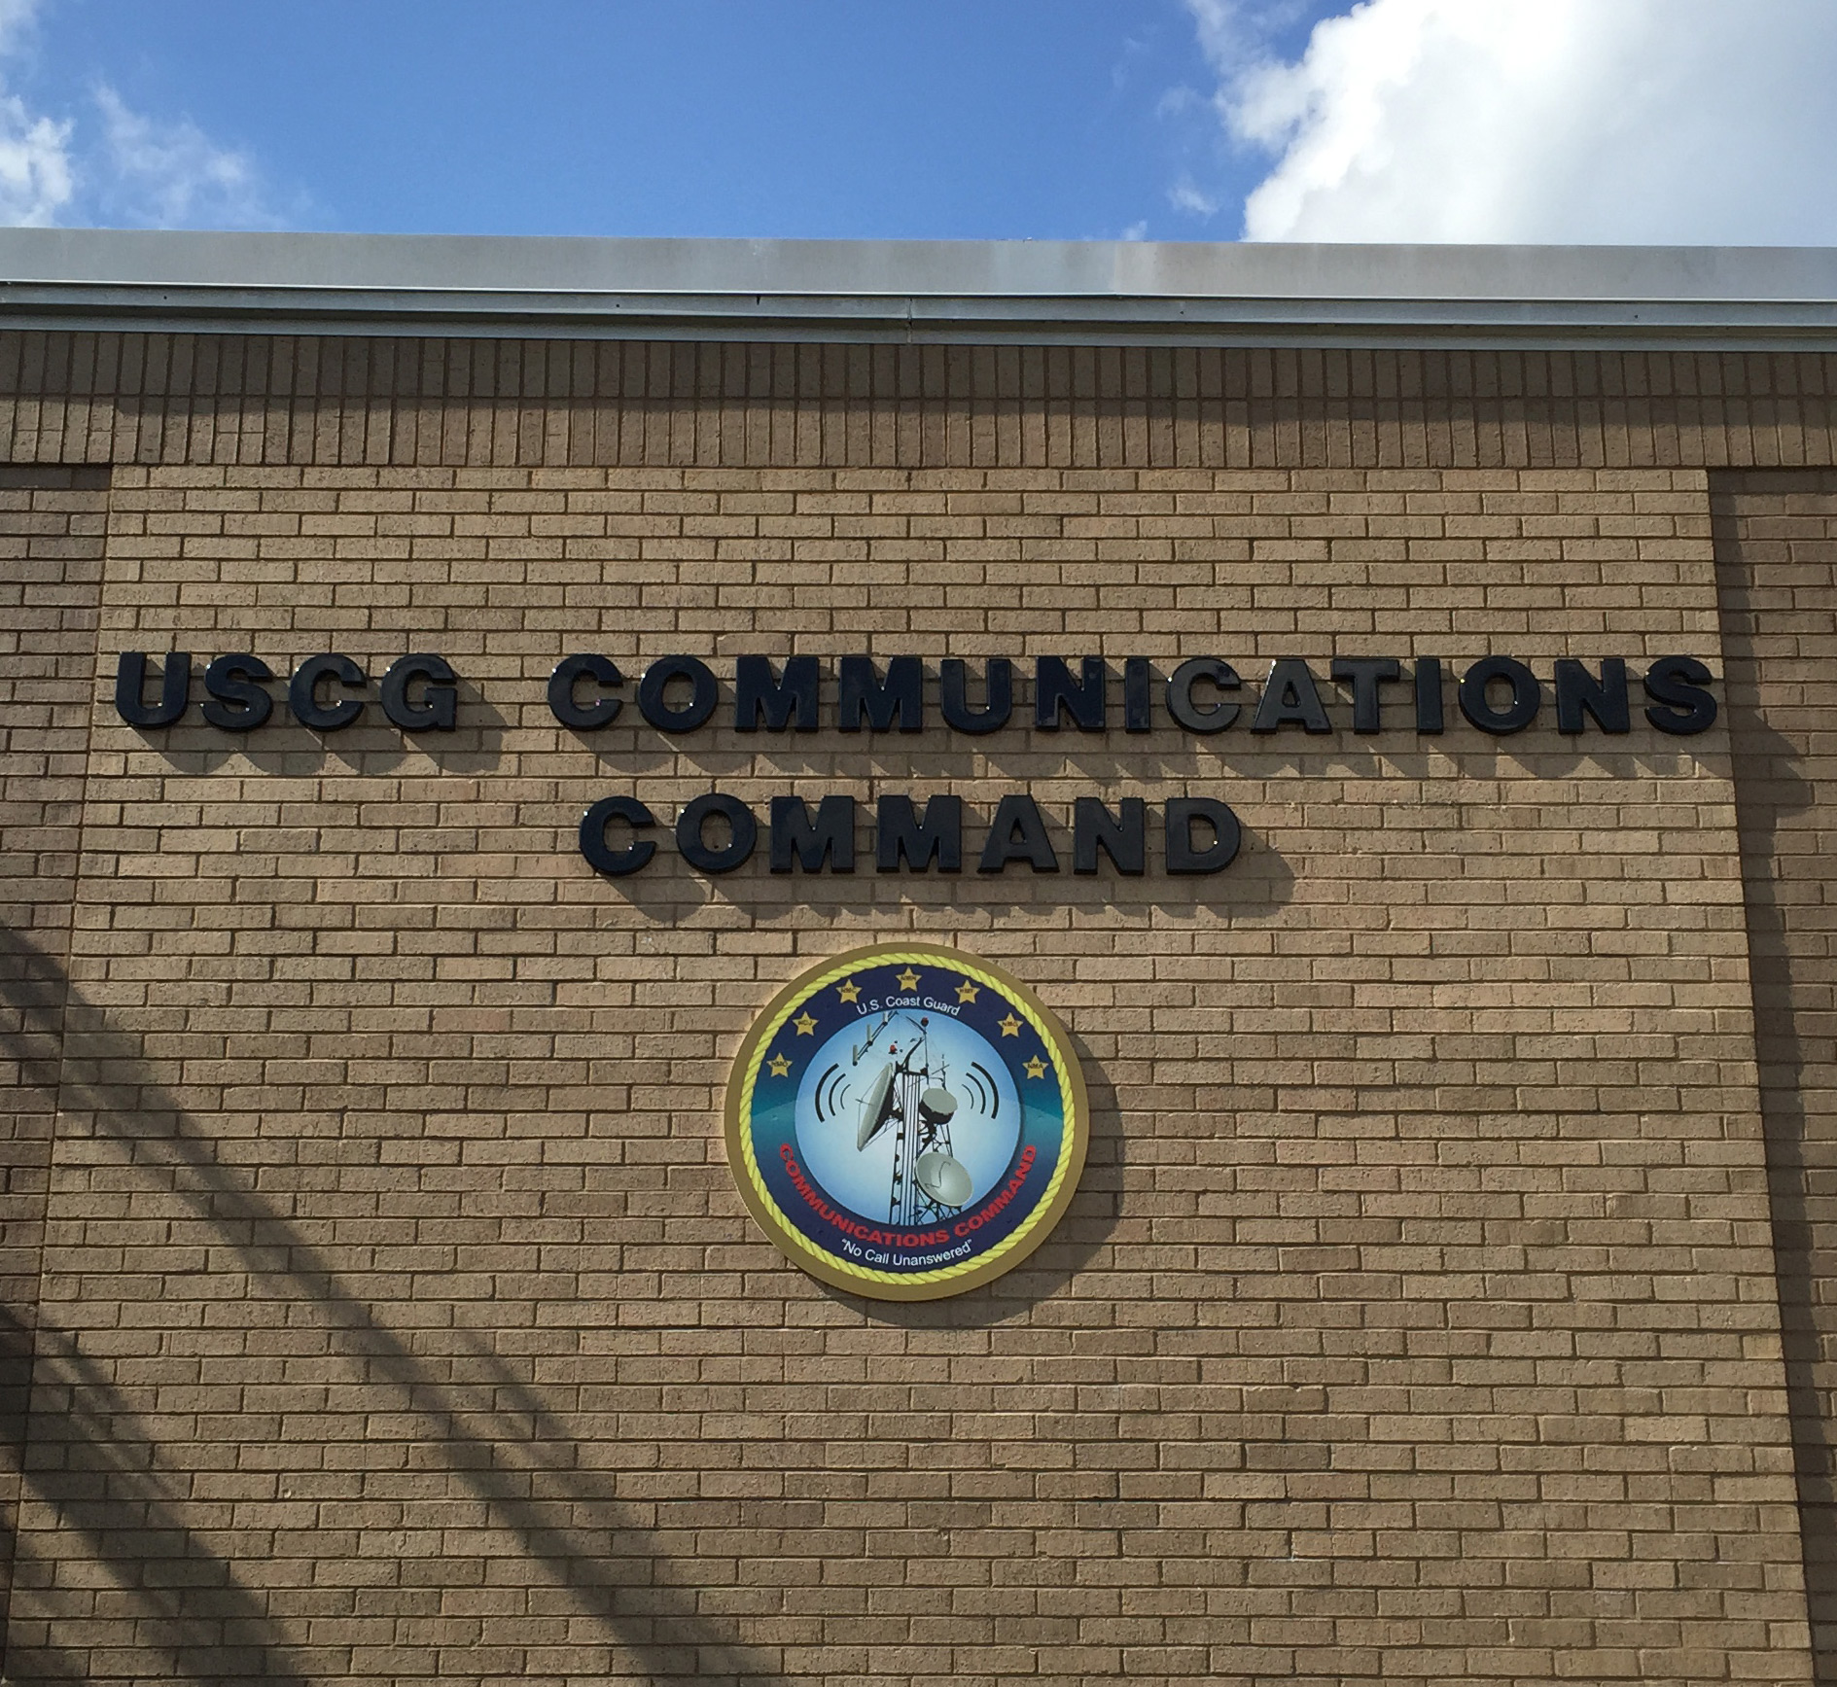

Slide 34
CHANGE AGENTS
Technology – voice to digital communications
Wide band VHF shifts to narrowband NTIA compliant, except for Marine channels
GMDSS replaces traditional SSB MF/HF distress messaging
August 1, 2013 - Coast Guard halted monitoring of 2182 MHz SSB for distress calls and 2670 KHz VOBRA
Rescue 21 implemented for Sea Area 1, VHF
COMMCOM Email of July 2015
http://wow.uscgaux.info/Uploads_wowII/R-DEPT/COMMCOM_MEMO_SMLL_SIZE.pdf
Auxiliary TC Concept of Operations released in 2016
34

Slide 35
AUXILIARY COMMUNICATIONS SYSTEM - 2016 & Beyond
VHF Communications
MF/HF Communications
Station Watch Standing
AUXMON
SHARES
AUGCOM
35

Slide 36
AUGCOM MISSION
Specifics of AUGCOM mission released Mar. 31, 2016 See //rdept.cgaux.org/documents/Comms/AuxiliaryCommunicationsProgramSOP.pdf
Directly supports the CG COMMCOM, Sectors and other CG Commands
Aids response to GMDSS HF maritime services for sea area A-2
Participants are a select group of qualified Auxiliary HF facilities and designated as AUGCOMSTA
http://rdept.cgaux.org/documents/Comms/AUGCOM/AUGCOM%20Recruiting%20Statement%20rev926.pdf
36

Slide 37
WHAT IS A FACILITY?
The Coast Guard counts assets; vessels, aircraft, and radios
DIRAUX assigns each asset a facility identification number; i.e. OPFAC # for a vessel, or Facility ID for a radio i.e. NF81AA
The identification number is for record keeping only. You must insert this facility identification number in the box in Section III of the Mission Hour, Form 7030, where it calls for a facility registration number
37

Slide 38
WHAT IS A FACILITY ?(con’t)
DIRAUX approves VHF radio callsigns, which may be assigned by DIRAUX or the District CM Staff
E.g. “Auxiliary Boston Radio”, where Boston signifies the location. DIRAUX does not issue Auxiliary HF callsigns
HF facility owners must forward a copy of their DIRAUX accepted Offer for Use Form 7004 to DVC-RT and BC-RTI for issuance of their HF callsign
38

Slide 39
FIXED LAND FACILITIES
Fixed land facilities are permanently located in an Auxiliary Communications Unit (ACU) either owned by the Auxiliary or in the residence, or similar building, owned by the radio facility owner
The location is FIXED and DIRAUX must authorize relocation of the radio facility via Form 7004
39

Slide 40
MOBILE RADIO FACILITIES
Mobile radio facilities are usually mounted in vehicles and can be used while the vehicle is in motion
Handheld radios are considered to be mobile
Movement at the direction of the CG requires orders via the AOM process
They are not to be confused with TRANSPORTABLE radio facilities
40

Slide 41
WHAT IS A TRANSPORTABLE FACILITY?
A station which is transferred to various fixed locations but is not intended to be used while in motion
Examples:
Go-kit
Trailer
Boxed radio with accessories
41

Slide 42
TRANSPORTABLE (Cont.)
A transportable station is normally configured to permit it to be easily transported and set up for operation in various temporary locations
A transportable station should be ready for emergency deployment at all times, but is not used on a regular basis and is not used at a permanent location
Movement at the direction of the CG requires orders via the AOM process
42

Slide 43
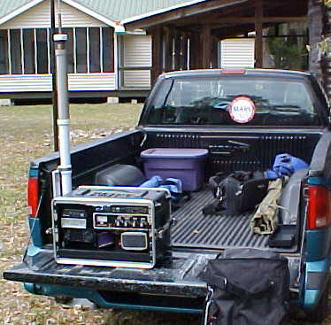
TRANSPORTABLE FACILITY
t
An example of a transportable radio facility is shown on the tailgate of the truck
43

Slide 44
Mishap Reporting
ALL mishaps must be reported to the Order Issuing Authority (OIA)
With or without injuries
Even if there is no damage
Mishap does not equal punishment
Accidents happen
Not reporting a mishap DOES lead to punitive action
Note: A Coast Guard mishap is defined as any unplanned, unexpected or undesirable event that causes injury, occupational illness, death, material loss or damage.
44
Notes:
Why are they requesting that all mishaps; with or without injuries and even if there is no damage are reported?
Whenever a mishap occurs, even with no real damage or injury, is reported this information can be used to aid other members of potential risks and how this risk can be avoided.
This information you provided can be used as a learning or teaching event that can help all of us to become safer.

Slide 45
Why Mishap Reporting
Why should I report every mistake I make even if there is only a minor injury, or negligible damage?
Remember Mishap reporting is NOT for assigning blame or punishment
It is for education and an overall goal of process improvement
Analysis of all mishaps can lead the Auxiliary and Active duty to review training, policies, procedures to make improvements in the safety of all missions in the future
Stop the small mistakes and the big mistakes are less likely to happen
45

Slide 46
AOM Considerations
When a Mobile Radio Facility is directed to move, AOM orders are required
When a Transportable Radio Facility is directed to move, AOM orders are required
In those situations where an operator (TCO), under orders, travels from home to arrive at a Fixed Land ACU, they are not eligible for AOM travel reimbursement. Depending on their ACU duty hours, relative to meal time, they may request reimbursement for meals through the AOM process
46

Slide 47
WHAT IS NOT A TRANSPORTABLE FACILITY?
A mobile facility where the intention is to be able to move the radio from the vehicle to another site – NO!
A fixed facility where the intention is to be able to move the radio to another site – NO!
WHY NOT! – This encourages double counting of available radio assets. If I remove the radio from my vehicle then I have reduced the availability of mobiles by one - Ask a COML!
47

Slide 48
PROWORDS - Reminders
Remember, ROGER, WILCO, OVER and OUT?
They are all prowords, but are never used together at the same time
ROGER means I heard you and understand what you said
48

Slide 49
PROWORDS (Cont.)
All transmissions end with either OVER or OUT or WAIT or WAIT-OUT
OVER means you are expecting a reply from the other station
OUT means your exchange is over and no other transmissions will follow
49

Slide 50
PROWORDS (Cont.)
WAIT means everyone should stand by and you will be back in a few seconds
WAIT-OUT means for everyone to stop transmitting and wait for you to return after a short period of time
WILCO means you understand and will comply
Roger, good copy- WRONG! Why?
What should you say????
50
Notes:
ROGER – already means I understand and will comply there is no need for “good Copy”
Response possibly replies to “did you hear my last”
I hear you loud and clear
I hear you weak but garbled
Please repeat transmission was broken up

Slide 51
MARINE CHANNEL 16
Channel 16 is the international emergency/distress and calling channel
Always monitor channel 16 unless there is a specific reason to monitor another channel (regatta, SAR case, guard channel, etc.)
Encourage all boaters to monitor channel 16 when underway
51

Slide 52
National Contact Information
Chief, Telecommunication Division
COMO David Elliot, DVC-RT
David.Elliot@cgauxnet.us
772-781-5969
Contingency Communications
David Rockwell, BC-RTC
david.rockwell@cgauxnet.us
727-823-7580
Qualification and Training
John Holmes BC-RTQ
john.holmes@cgauxnet.us
707-683-8971
Program Integration
Don Wellons BC-RTI
donald.wellons@cgauxnet.us
912-266-4041
Coast Guard Support
Denis Rossiter BC-RTS
p.denis.rossiter@cgauxnet.us
717-249-9047
52

Slide 53
Bravo Zulu!
Thank you for your participation!
We seek your feedback on the content of this presentation.
Send your comments to:
Bruce.pugh@cgauxnet.us DVC-RE
Davida Kellogg BC-REI
Bruce Pugh, DVC-RE
David Elliot, DVC-RT
Rick Saunders, DIR-R
Roy Savoca, DIR-Rd

