Slide 1
2017 Telecommunications Workshop

Slide 2
Welcome
This workshop has been developed to:
Review existing policies and procedures
Overview current communications programs and missions
Preview new programs, procedures, and missions
This is an optional workshop, but it may be “required” at the local level for all Telecommunications Operators (TCO)

Slide 3
Ground Rules
This workshop should be interactive, NOT a Lecture
Ask Questions
Answer Questions
Share Experiences
Share Insights
Participate – Participate - Participate

Slide 4
CONCEPT OF OPERATIONS
CONCEPT OF OPERATIONS – CONOPS - http://rdept.cgaux.org/documents/Comms/AuxiliaryCommunicationsProgramSOP.pdf - was released on 21 March, 2016 for Auxiliary Communications and is intended to provide a foundation for the growth and development of current Auxiliary communications capabilities while conveying to the US Coast Guard Auxiliary (CGAUX) and the US Coast Guard (CG), the role, assets, activities, operations and overall policies of the Auxiliary Communication System (ACS)
Communication officers at all levels, will be responsible for maintaining an accurate radio communications resource availability list. (See: ICS Form 217A CG)

Slide 5
Authorized Operation of Radio Facilities
Only Qualified Auxiliarists may activate Auxiliary fixed land, land mobile, and RDF facilities under one or more of the following conditions:
• For a mission ordered or scheduled by the Coast Guard
• When necessary to handle valid distress traffic
• While conducting technical tests to determine a facility’s capability (e.g., facility inspection)
• When necessary to contact a Coast Guard unit to determine if Auxiliary help is required

Slide 6
Authorized Operation of Radio Facilities (con’t)
When conducting net drills
For assisting in time of disasters or national emergencies
• When necessary to conduct authorized Auxiliary activities as assigned by appropriate Auxiliary Operational Commanders or Staff officers
Reference: Operations Policy Manual, Annex 4.C.4
6

Slide 7
Authorized Operation of Radio Facilities (con’t)
“Qualified Auxiliarists” must have completed AUXCOM prior to August 1, 2008 or be TCO/PQS qualified
Qualified Auxiliarists may offer their radios to be used as Auxiliary facilities. If accepted, a facility identification for all radios HF and VHF will be assigned by DIRAUX and the information entered in Auxdata
DIRAUX issues all VHF callsigns. The DVC-RT issues all HF callsigns
7

Slide 8
Radio Basics
In all radio communications, we are to act as professionals
At no time shall we make reference to ethnicity, race, gender, sexual orientation or religious affiliation in radio transmissions
This is a zero tolerance policy and must be strictly adhered to

Slide 9
Radio Basics (con’t)
It is often not what you say, but how you say it that demonstrates your professionalism
Brevity and accuracy supports mission success and safety
Remember, the public and other agencies “hear” you as the voice of the U.S. Coast Guard
Practice and use proper radio procedures to achieve success, safety, and professionalism
No “10” codes, no “Over and Out”, etc.

Slide 10
Radio Basics (Cont.)
REMEMBER:
When you key the microphone on your radio “The Whole World is Listening!”
Always listen before transmitting and be sure you are on the correct channel (frequency)

Slide 11
VHF Communications
7 CG Auxiliary LMR narrow band VHF frequencies are available for our use on narrow band radios with maximum allowed output power of 50 watts
VHF repeaters are allowed an output power of 100 watts
Maximum output power on Marine channels, 25 watts
No power amplifiers allowed on VHF radios
Notes:
There are 37 other LMR frequencies allotted to the Coast Guard by NTIA, but not the Auxiliary.
For our purposes 136-174 MHz frequency range., excluding the 2 Mtr. Amateur band, 144-148 MHz.
Encrypted radios are loaned on an as needed basis and returned after the event ends.

Slide 12
VHF Communications (con’t)
RDF (Radio Direction Finding) stations are authorized
No encryption allowed on AUX radios
VHF hand held marine radios MAY be accepted as mobile facilities in special cases
APRS is not authorized
MMSI numbers are not authorized for Auxiliary aircraft

Slide 13
VHF REPEATERS
There are 56 Auxiliary VHF repeaters throughout the United States, most of which share common input/output frequencies, with varied CTCSS tone access. Most are unit owned
Repeater requests (CG Form 6086) must be reviewed by CG Office of Spectrum Management before
Maximum output power of 100 watts
Narrowband only
7 programmable frequencies

Slide 14
HF Communications
HF serves as a platform for other missions:
- AUXMON (Auxiliary Monitoring Mission) A quality control program for Coast Guard broadcasts
- AUGCOM GMDSS monitoring for digital and SSB voice distress calls (replaces the old SSB voice distress calls) http://rdept.cgaux.org/documents/Comms/AUGCOM/AUGCO M%20Mission%20Final%20to%20BSX%202016_PDF.pdf
- SHARES – A DHS administered radio program that coordinates a voluntary network of government, industry, and disaster response agency HF radio stations used for emergency communications

Slide 15
HF Communications (con’t)
Maximum power output 1000 watts on HF radios
Usable for Auxiliary HF radio Nets
41 frequencies 2-23 MHz are available
Radios must be able to transmit outside of Amateur bands
Accommodates digital modes
Supports CG contingencies and SHARES
Reference: http://rdept.cgaux.org/documents/BeQualified/BecomingQualifiedAuxiliaryHighFrequencyProgram.pdf

Slide 16
Copyright ©2004 Coast Guard Auxiliary Association, Inc.
16
Notes:
HF Net Managers located in OR, Southern CA, NM, Wisconsin, TN, North FLA, Central FLA, PA.

Slide 17
CG Station Radio Watchstanding
Auxiliary Watchstanders at a CG station must complete the same training as active duty CG watchstanders and stand a “board examination”
They must have received, or applied for, DO security clearance prior to being certified as a CG Watchstander
Watchstanders serve at the Station CO’s discretion
AUXCOM or TCO/PQS are helpful and might be required at the discretion of the station OIC

Slide 18
Auxiliary Station Watchstander
Watchstanders at an Auxiliary Communications Unit (ACU) must be certified as TCO or completed Auxcom prior to August 1, 2008
Other requirements might be required, on a District to District basis
A radio watch requires that the station is actively manned and the operator is ready for intervention

Slide 19
SHARES (Shared Resources)
Administered by DHS
This program provides the Federal emergency response community with a single interagency emergency message handling and frequency spectrum management system
SHARES promotes interoperability between HF radio systems used by Federal departments and agencies and monitors applicable regulatory, procedural, and technical issues

Slide 20
SHARES (con’t)
Only use the Auxiliary furnished application, Form 1, available only from DVC-RT
Do not use SHARES furnished application
Use Auxiliary HF call sign when logging into a SHARES net
The DVC-RT acts as only a facilitator of the application process
See: http://www.dhs.gov/shares

Slide 21
AUXMON
The AUXMON program members monitor the HF Coast Guard broadcasts to mariners and reports any problems to the CG
HF radio equipment and special software is required to participate in the AUXMON program
Additional AUXMON members are needed
For application, please see: http://rdept.cgaux.org/documents/Comms/AUXMONApplicationrs.pdf

Slide 22
AUXMON (Cont.)
AUXMON stations monitor CG broadcasts to mariners on stations located on the East Coast, Gulf Coast and Pacific Coast
The Coast Guard broadcasts are by voice and digital, all on HF marine frequencies
The Coast Guard also broadcasts HF fax weather maps

Slide 23
AUXMON (Cont.)
If AUXMON stations detect a problem with one of the CG broadcasts to mariners they immediately notify CG Communications Command (CommCom)
AUXMON members are the “ears” for the Coast Guard

Slide 24
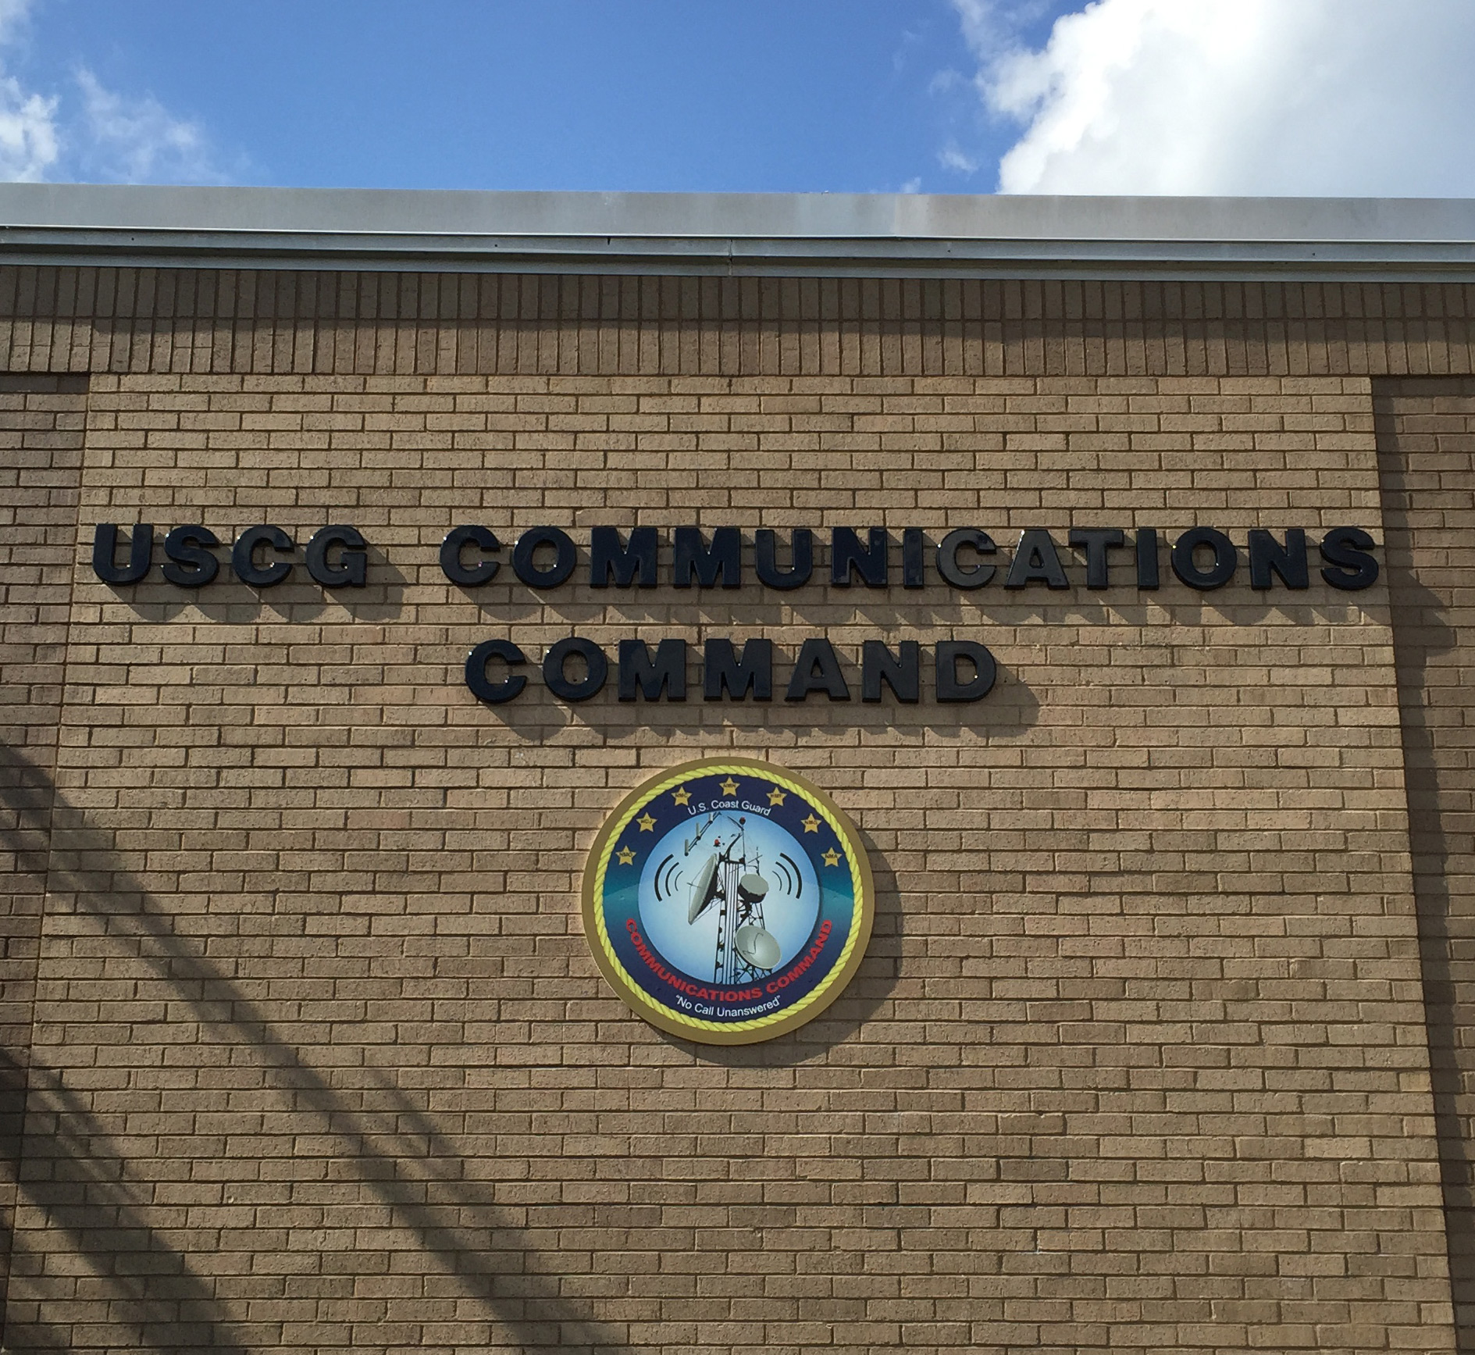

Slide 25
CHANGE AGENTS
Technology – voice to digital communications
Wide band VHF shifts to LMR narrowband and NTIA compliant, except for Marine channels
GMDSS replaces traditional SSB MF/HF distress messaging
August 1, 2013 - Coast Guard halts monitoring of 2.182 MHz SSB for distress calls and 2.670 MHz VOBRA
Rescue 21 implemented for Sea Area 1, VHF
COMMCOM Email of July 2015
http://wow.uscgaux.info/Uploads_wowII/R-DEPT/COMMCOM_MEMO_SMLL_SIZE.pdf
Concept of Operations released in 2016

Slide 26
AUXILIARY COMMUNICATIONS SYSTEM - 2016 & Beyond
VHF Communications
MF/HF Communications
Station Watch Standing
AUXMON
SHARES
AUGCOM

Slide 27
AUGCOM MISSION
Specifics of AUGCOM mission released Mar. 31, 2016 See //rdept.cgaux.org/documents/Comms/AuxiliaryCommunicationsProgramSOP.pdf
Directly supports the CG COMMCOM, Sectors and other CG Commands
Aids response to GMDSS HF maritime services for sea area A-2
Participants are a select group of qualified Auxiliary HF facilities and designated as AUGCOMSTA
http://rdept.cgaux.org/documents/Comms/AUGCOM/AUGCOM%20Recruiting%20Statement%20rev926.pdf

Slide 28
WHAT IS A FACILITY?
The Coast Guard counts assets; vessels, aircraft, and radios
DIRAUX assigns each asset a facility identification number; i.e. OPFAC # for a vessel, or Facility ID for a radio i.e. NF013ZA
The identification number is for record keeping only. You must insert this facility identification number in the box in Section III of the Mission Hour, Form 7030. NOTE this box incorrectly calls for a registration number

Slide 29
WHAT IS A FACILITY ?(con’t)
DIRAUX also assigns all VHF radio facilities a callsign i.e. “Auxilary Radio Boston”, where Boston signifies the location. DIRAUX does not issue Auxiliary HF callsigns
HF facility owners must forward a copy of their DIRAUX accepted Offer for Use Form 7004 to DVC-RT and BC-RTI for issuance of their HF callsign

Slide 30
FIXED LAND FACILITIES
Fixed land facilities are permanently located in an Auxiliary Communications Unit (ACU) either owned by the Auxiliary or in the residence, or similar building, owned by the radio facility owner
The location is FIXED and DIRAUX must authorize relocation of the radio facility via Form 7004

Slide 31
MOBILE RADIO FACILITIES
Mobile radio facilities are usually mounted in vehicles and can be used while the vehicle is in motion
Handheld radios are considered to be mobile
Movement at the direction of the CG requires orders via the AOM process
They are not to be confused with TRANSPORTABLE radio facilities

Slide 32
WHAT IS A TRANSPORTABLE FACILITY?
A station which is transferred to various fixed locations but is not intended to be used while in motion
Examples:
Go-kit
Trailer
Boxed radio with accessories

Slide 33
TRANSPORTABLE (Cont.)
A transportable station is normally configured to permit it to be easily transported and set up for operation in various temporary locations
A transportable station should be ready for emergency deployment at all times, but is not used on a regular basis and is not used at a permanent location
Movement at the direction of the CG requires orders via the AOM process

Slide 34
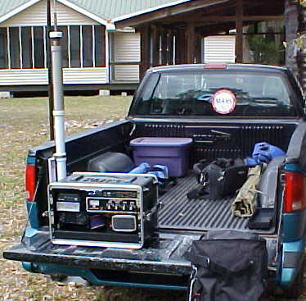
TRANSPORTABLE FACILITY
t
An example of a transportable radio facility is shown on the tailgate of the truck

Slide 35
AOM Considerations
When a Mobile Radio Facility is directed to move, AOM orders are required
When a Transportable Radio Facility is directed to move, AOM orders are required
In those situations where an operator (TCO), under orders, travels from home to arrive at a Fixed Land ACU, they are not eligible for AOM travel reimbursement. Depending on their ACU duty hours, relative to meal time, they may request reimbursement for meals through the AOM process

Slide 36
WHAT IS NOT A TRANSPORTABLE FACILITY?
A mobile facility where the intention is to be able to move the radio from the vehicle to another site – NO!
A fixed facility where the intention is to be able to move the radio to another site – NO!
WHY NOT! – This encourages double counting of available radio assets. If I remove the radio from my vehicle then I have reduced the availability of mobiles by one - Ask a COML!

Slide 37
PROWORDS - Reminders
Remember, ROGER, WILCO, OVER and OUT?
They are all prowords, but are never used together at the same time
ROGER means I heard you and understand what you said

Slide 38
PROWORDS (Cont.)
All transmissions end with either OVER or OUT or WAIT or WAIT-OUT
OVER means you are expecting a reply from the other station
OUT means your exchange is over and no other transmissions will follow

Slide 39
PROWORDS (Cont.)
WAIT means everyone should stand by and you will be back in a few seconds
WAIT-OUT means for everyone to stop transmitting and wait for you to return after a short period of time
WILCO means you understand and will comply
Roger, good copy- WRONG! Why?
What should you say????

Slide 40
MARINE CHANNEL 16
Channel 16 is the international emergency/distress and calling channel
Always monitor channel 16 unless there is a specific reason to monitor another channel (regatta, SAR case, etc.)
Encourage all boaters to monitor channel 16 when underway

Slide 41
National Contact Information
Contingency Communications
John Holmes BC-RTC
john.holmes@cgauxnet.us
707-683-8971
Qualification and Training
Vacant BC-RTQ
Chief, Telecommunication Division
Gary G. Young DVC-RT
gary.young@cgauxnet.us
781-581-6659
Program Integration
Don Wellons BC-RTI
donald.wellons@cgauxnet.us
912-266-4041
Coast Guard Support
Denis Rossiter BC-RTS
p.denis.rossiter@cgauxnet.us
717-249-9047

Slide 42
Bravo Zulu!
Thank you for your participation!
We seek your feedback on the content of this presentation.
Send your comments to: BC-RTQ
Davida Kellogg BC-REI
Bruce Pugh, DVC-RE
Gary Young, DVC-RT
John J Slattery, DIR-R
, DIR-Rd

