Slide 1
National Response Directorate 2016 Telecommunications Workshop

Slide 2
Welcome
This workshop has been developed to:
Review existing policies and procedures
Overview current communications programs and missions
Preview, soon to be announced (TBA) programs and missions
Note: Although this is an optional workshop, it can be “required” at the local level for all Telecommunications Operators (TCO)

Slide 3
Ground Rules
This workshop should be interactive, NOT a Lecture
Ask Questions
Answer Questions
Share Experiences
Share Insights
Participate – Participate - Participate

Slide 4
Authorized Operation of Radio Facilities
Qualified Auxiliarists may only activate Auxiliary fixed land, land mobile, and RDF facilities under one or more of the following conditions:
• For a mission ordered or scheduled by the Coast Guard
• When necessary to handle valid distress traffic
• While conducting technical tests to determine a facility’s capability (e.g., facility inspection)
• When necessary to contact a Coast Guard unit to determine if Auxiliary help is required

Slide 5
Authorized Operation of Radio Facilities (con’t)
When conducting net drills
For assisting in time of disasters or national emergencies
• When necessary to conduct authorized Auxiliary activities as assigned by appropriate Auxiliary Operational Commanders or Staff officers
Reference: Operations Policy Manual, Annex 4.C.4
5

Slide 6
Radio Basics
In all radio communications, we are to act as professionals
At no time shall we make reference to ethnicity, race, gender, sexual orientation or religious affiliation in radio transmissions
This is a zero tolerance policy and must be strictly adhered to

Slide 7
Radio Basics (con’t)
It is often not what you say, but how you say it that demonstrates your professionalism
Brevity and accuracy supports mission success and safety
Remember, the public and other agencies “hear” you as the voice of the U.S. Coast Guard
Practice and use proper radio procedures to achieve success, safety, and professionalism

Slide 8
VHF Communications
7 Marine channels 1/25 watts
7 LMR narrow band frequencies, 50 watts
Others by CG Spectrum Management approval only
46 Repeaters allowed on LMR frequencies with CG Spectrum Management approval. AUX Repeater Policy (TBA 2016)
Only Part 80 Marine or Part 90 narrow band radios
Notes:
There are 37 other LMR frequencies allotted to the Coast Guard by NTIA, but not the Auxiliary.
For our purposes 136-174 MHz frequency range., excluding the 2 Mtr. Amateur band, 144-148 MHz.
Encrypted radios are loaned on an as needed basis and returned after the event ends.

Slide 9
VHF Communications (con’t)
RDF station authorized
No encryption allowed on AUX radios
No power amplifiers allowed
VHF Policy (Pending)
APRS is not authorized
MMSI numbers are not authorized for Auxiliary aircraft

Slide 10
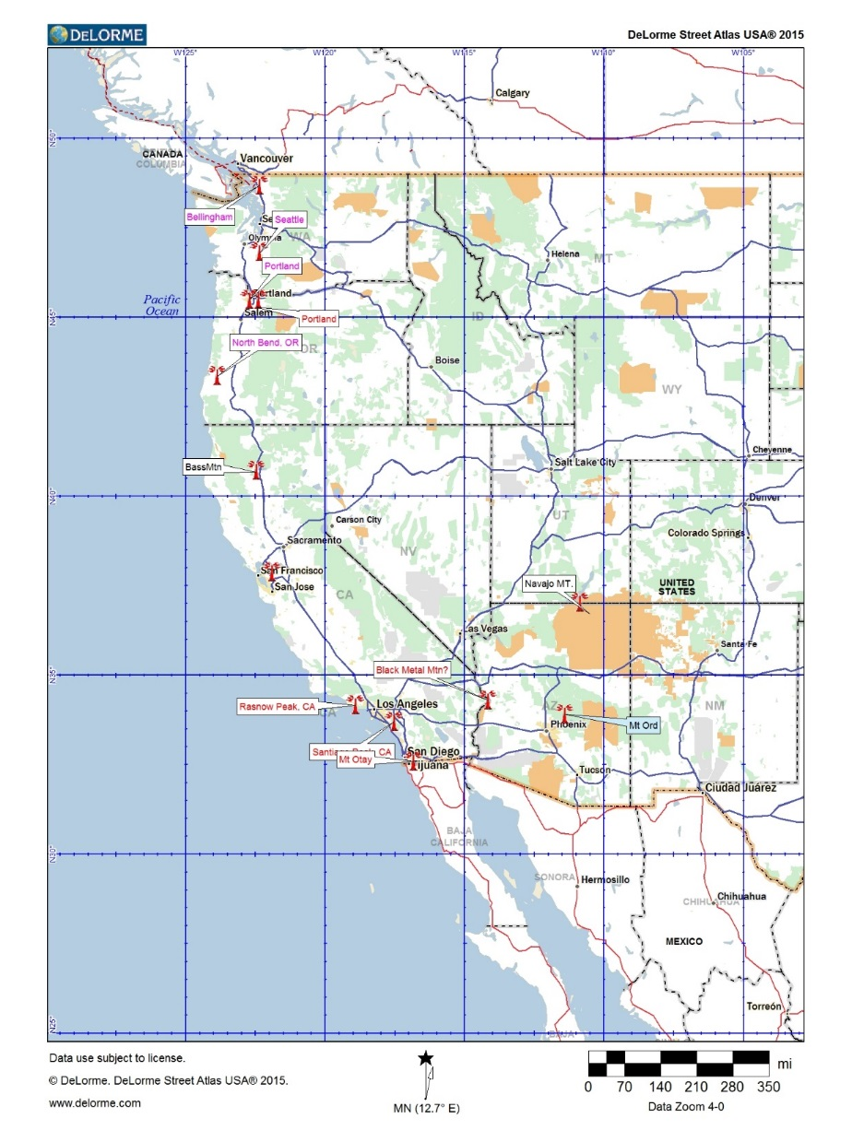
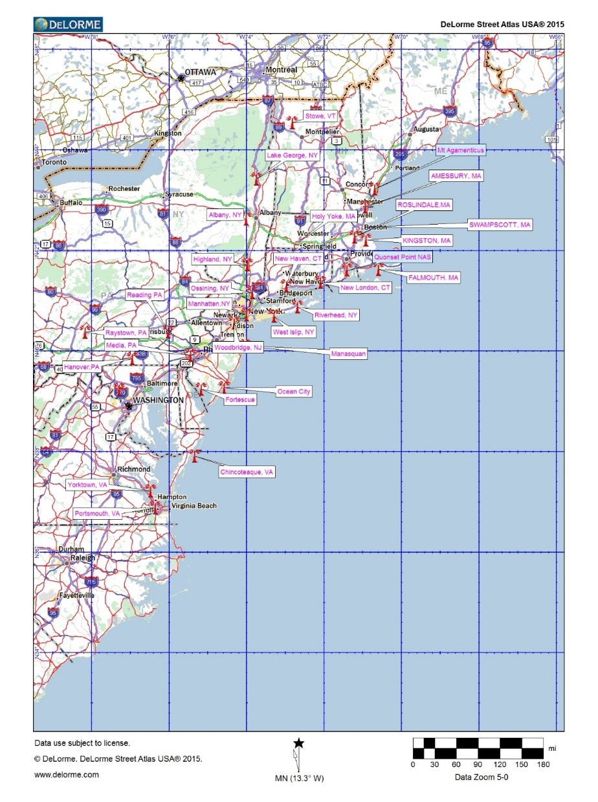
VHF REPEATERS

Slide 11
HF Communications
Serves as a platform for other missions
Auxiliary Monitoring Mission (AUXMON) - A quality control program for the Coast Guard
SHARES – A Radio Program that coordinates a voluntary network of government, industry, and disaster response agency HF radio stations used for emergency communications
Augmentation Communications Mission (AUGCOM TBA 2016) – GMDSS distress monitoring in support of Coast Guard Communications Command (COMMCOM)

Slide 12
HF Communications (con’t)
Maximum power output 1000 watts
Usable for AUXNETS
41 frequencies 2-23 MHz Radios must be able to transmit outside of Amateur bands
Accommodates digital modes
Supports CG contingencies
Reference: http://rdept.cgaux.org/documents/BeQualified/BecomingQualifiedAuxiliaryHighFrequencyProgram.pdf

Slide 13
Copyright ©2004 Coast Guard Auxiliary Association, Inc.
13
Notes:
HF Net Managers located in OR, Southern CA, NM, Wisconsin, TN, North FLA, Central FLA, PA.

Slide 14
Station Radio Watchstanding
Administered by each CG station.
Please see: Communications Watchstander
Qualification Guide, COMDTINST M16120.79series)
AUXCOM or TCO/PQS not required for CG station watchstander, but helpful
If station is only Auxiliary manned, TCO/PQS after Aug. 2008 or AUXCOM before Aug. 2008 is required. Some districts may have extra requirements
A radio watch requires that the station is actively manned and the operator is ready for intervention

Slide 15
SHARES
This program provides the Federal emergency response community with a single interagency emergency message handling and frequency spectrum management system
SHARES promotes interoperability between HF radio systems used by Federal departments and agencies and monitors applicable regulatory, procedural, and technical issues
62 Auxiliary HF facilities have applied to SHARES
Never send SHARES documents via open e-mail

Slide 16
SHARES (con’t)
Only use the Auxiliary furnished application, Form 1, available only from DVC-RT
Do not use SHARES furnished application
Use Auxiliary HF call sign when logging into a SHARES net
The DVC-RT acts as only a facilitator of the application process
See: http://www.dhs.gov/shares

Slide 17
AUXMON
50 Stations enrolled in program, 36 in LANT, 14 in PAC
Must possess an HF facility with Auxiliary call sign
Quality control by monitoring CG HF broadcasts.
Requires time commitment
For application, please see: http://rdept.cgaux.org/documents/Comms/AUXMONApplicationrs.pdf

Slide 18
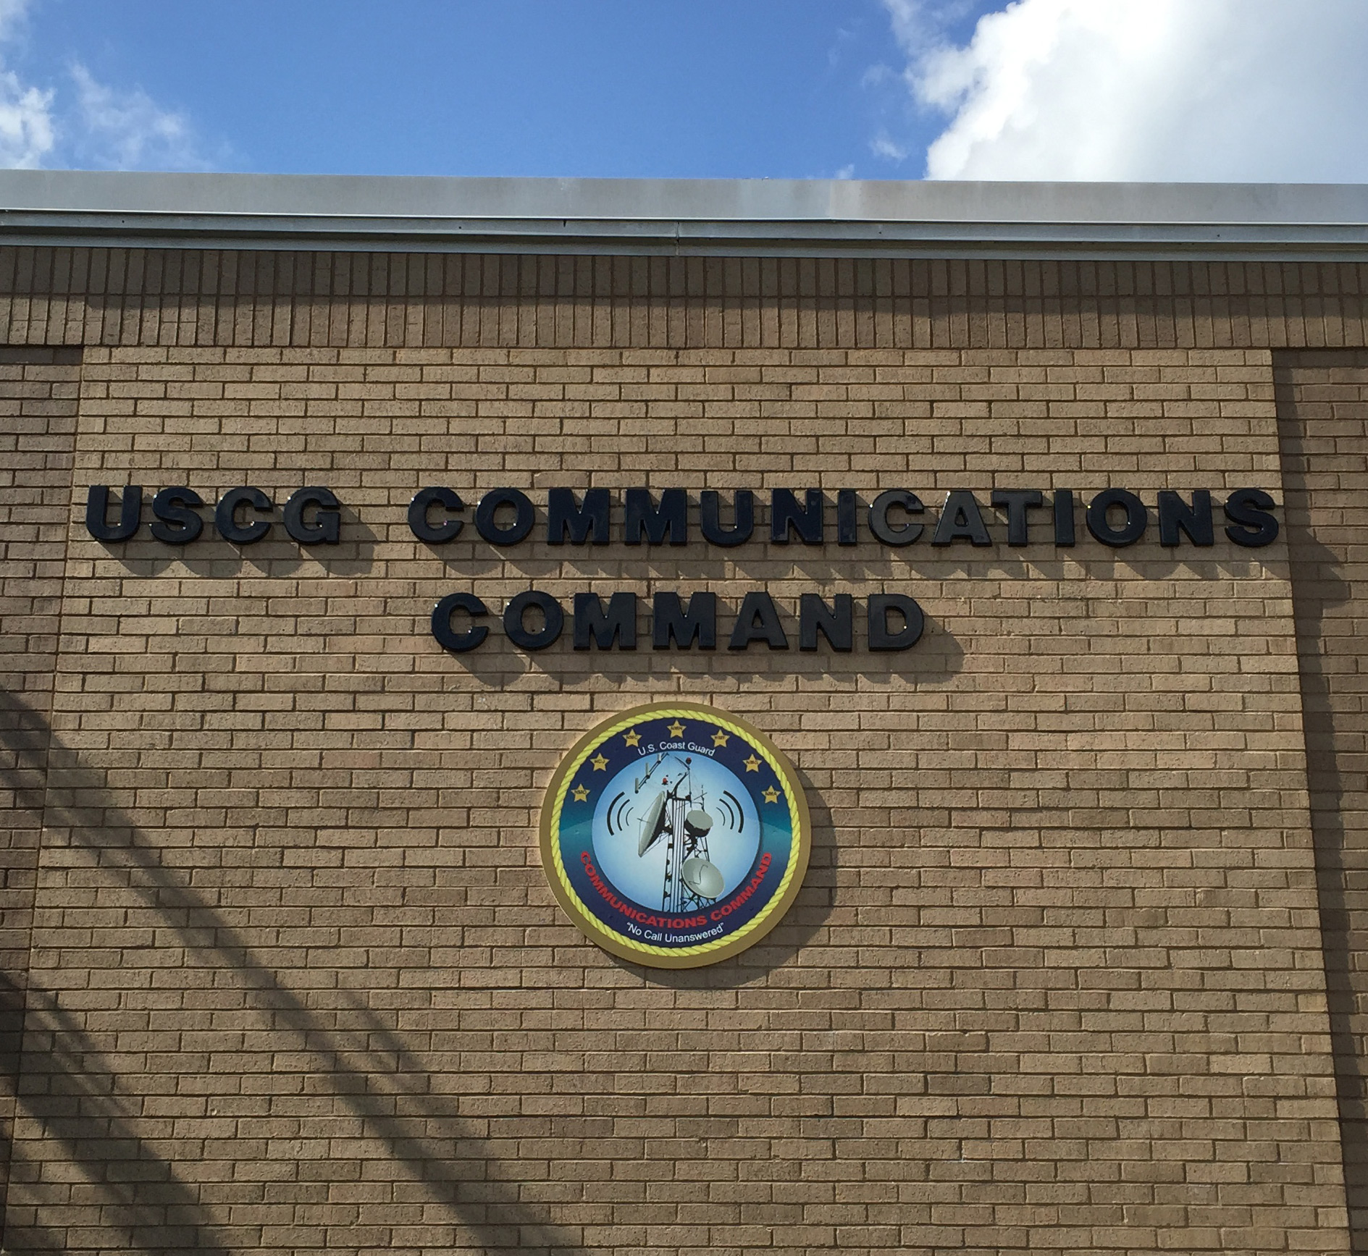

Slide 19
COMMCOM
Note: The content of this slide and the following three slides are taken from a letter sent from A.T. Campen, CDR, CG CAMSLANT on 3 March, 2015 to Auxiliary DIR-Rd
How the Coast Guard manages and operates its radio stations has changed. Last summer that relationship and associated responsibilities changed
The change was implemented under a Coast Guard Headquarters COMMSYS reorganization project called the Communications Command (COMMCOM)
Neither our relationship nor monitoring/QA efforts with the Auxiliary will change with the migration to COMMCOM
Nor will any of our radio broadcasts or operations that the COMMSYS currently performs

Slide 20
COMMCOM (con’t)
The COMMCOM, which is the new name of CAMSLANT in Chesapeake, VA (NMN), will be the only command in the COMMSYS
The Coast Guard decommissioned CAMSPAC (NMC), Kodiak (NOJ), Honolulu (NMO), New Orleans (NMG), Miami (NMA), and Boston (NMF) last summer
All radio systems and operations from all of these stations will continue as before.
All the facilities (with the exception of NOJ) are no longer manned.
NOJ will still maintain a live radio watch in Kodiak

Slide 21
COMMCOM (con’t)
Kodiak lost their support staff, become a subordinate unit to the COMMCOM (NMN), and will be referred to as COMMS Det Kodiak
CAMSPAC also lost the majority of its staff and will no longer have a live radio watch. All of their radio operations, in addition to NOJ will be remoted to COMMCOM
NMC will keep approximately 23 people to support their contingency and training mission
They will be referred to as Mobile Contingency Communications (MCC) West and will be a subordinate unit to COMMCOM

Slide 22
Impact to the Auxiliary
In the end, the Coast Guard will continue to carry out all radio broadcasts and GMDSS alert and monitoring as normal. NOJ will do this for the D17 AOR, and COMMCOM (NMN) will do it for the rest of the Coast Guard’s AOR, including NMO.
For Auxiliary in the LANT AOR, nothing should change for your reporting, tasking or POCs
Auxiliary in HONO or PACAREA (minus D17), your POC and reporting has changed to COMMCOM

Slide 23
Impact to the Auxiliary (con’t)
There will still be a Chief Warrant Officer at COMMS Det West, whom you are encouraged to keep in touch and work with
Expect an increase in requests for AUXMON support, due to the un-manning of these radio stations and expected increased delay for repairs

Slide 24
CHANGE AGENTS
Technology – voice to digital communications
Wide band VHF shifting to LMR narrowband and NTIA compliant
GMDSS replaces traditional SSB MF/HF distress messaging
August 1, 2013 - Coast Guard halts monitoring of 2182 SSB for distress calls and 2670 VOBRA
Rescue 21 implemented for Sea Area 1, VHF
COMMCOM Email July 2015
http://wow.uscgaux.info/Uploads_wowII/R-DEPT/COMMCOM_MEMO_SMLL_SIZE.pdf
Concept of Operations (TBA 2016)

Slide 25
CONCEPT OF OPERATIONS
CONCEPT OF OPERATIONS – CONOPS (TBA 2016) for Auxiliary Communications is intended to provide a foundation for the growth and development of current Auxiliary communications capabilities while conveying to the US Coast Guard Auxiliary (CGAUX) and the US Coast Guard (CG), the role, assets, activities, operations and overall policies of the Auxiliary Communication System (ACS)
Communication officers at all levels, will be responsible for maintaining a radio communications resource availability list. (See: ICS Form 217A CG)

Slide 26
CONOPS (con’t)
Require every DCO to participate in quarterly communication drills conducted by their DSO-CM
DSO-CM’s and ADSO-CM’s are encouraged to participate in sponsored TELECONS with the national telecommunications staff, when held
CM officers are encouraged to share the annual “Communications Workshop” with all unit members possessing an approved Auxiliary radio facility

Slide 27
AUXILIARY COMMUNICATIONS SYSTEM - 2016 & Beyond
VHF Communications
MF/HF Communications
Station Watch Standing
AUXMON
SHARES
AUGCOM

Slide 28
AUGCOM MISSION
Specifics of AUGCOM mission TBA 2016
Directly supports the CG COMMCOM, Sectors and other CG Commands
Aids response to GMDSS HF maritime services for sea area A2, A3 and A4
Participants are a select group of qualified Auxiliary HF facilities and designated as AUGCOMSTA
http://rdept.cgaux.org/documents/Comms/AUGCOM%20Recruiting%20Statement.pdf

Slide 29
AUGCOMSTA REQUIREMENTS
Ability to receive, decode, record, and transmit digital messages via SEATTY or comparable software
Transmitter power output no less than (TBD) watts
Receiver meeting NTIA standards
Well tuned and matched antennas covering the GMDSS, DSC frequencies between 4 to 17 MHz
Long term emergency power
Presently fixed land only

Slide 30
Making an Application to Become a AUGCOMSTA
Submit the AUGCOMSTA application to the BC-RTC
You must prove that you have capability of receiving and decoding a GMDSS transmission and include it with your application
Once approved, you will be notified by the DVC-RT

Slide 31
AUGCOMOP (Operator) REQUIREMENTS
Must be both AUXCOM and TCO qualified
Only those operators qualifying as AUGCOMOP may be the lead operator at any time at an AUGCOM facility or operation
Applicant shall possess an understanding of HF/MF GMDSS/DSC and its significance within the SOLAS Treaty
Are owners of an approved USCGAUX HF radio facility which is properly equipped to monitor and report HF GMDSS/DSC, GMDSS and other forms of communications deemed suitable
Are specifically approved by the USCG Communications Area Master Station

Slide 32
FIXED LAND RECEIVER
Selectivity - The passband shall be no greater than the authorized bandwidth of emission and the slope of the selectivity characteristic outside the passband shall be 100 dB/kHz
Tunability - The equipment shall be capable of operation on any frequency within its tuning range.
Where a synthesizer is employed as the frequency controlling element, the receiver shall be capable of operation on any frequency which is an integral multiple of 0.1 kHz
NTIA Redbook 2013, 5.3.1.2
http://www.ntia.doc.gov/files/ntia/publications/redbook/2014-05/5_14_5.pdf

Slide 33
FIXED LAND TRANSMITTER
Frequency tolerance:
All, except SSB 10 Hz/SSB radiotelephone 20 Hz
NTIA Redbook, May 2014 rev., May 2013 ed., 5.3.1.1
http://www.ntia.doc.gov/files/ntia/publications/redbook/2014-05/5_14_5.pdf

Slide 34
FIXED LAND Antenna Standards
Directive antennas are not required below 4 MHz
Directive antennas shall be employed above 4 MHz unless in specific cases where they are shown to be impracticable
Minimum forward power gain over an isotropic radiator located at the same height over the same earth as directive antenna shall be 10 dB in the range 4 to 10 MHz and 15 dB in the range 10 to 30 MHz
The antenna gain in the desired direction over that of a lobe in any other direction shall be greater than 6 dB.
NTIA Redbook, May 2014 rev., May 2013 ed., 5.3.1.3
http://www.ntia.doc.gov/files/ntia/publications/redbook/2014-05/5_14_5.pdf

Slide 35
AOM Considerations
When Land Mobile and Transportable Facilities are required to move/change location they should request orders via AOM (AUXDATA Order Management) rather than using Form 7030.Per the Operations Policy Manual, mission orders must be submitted within 30 days after completion of the mission
Meals may be reimbursable, at CG subsistence rate, for Land Mobile and Transportable Facilities if the facility is required to move/change location
Mileage may be claimed for Land Mobile and Transportable Facilities that are required to move/change location

Slide 36
AOM (con‘t)
FINCEN does not pay for water, soda, snacks, etc.
If you receive fuel or meals from the Coast Guard at no cost, check “Government Provided” box
Orders through AOM are all electronically requested and submitted
Entry into AUXDATA is automatic – no separate 7030 required

Slide 37
AOM Permission Changes
All OIA functions are restricted to E-6/GS-7 or above, to include:
Create DIRAUX or OIA Add active duty users
Create users/owners Manage user permissions
Request open orders Approve patrol requests Deny patrol requests Reactivate orders Approve crew overrides Submit without SAMA
Submit orders to FINCEN Manage patrol areas
View district/location reports Allocate district funds
Add/update district accounting codes

Slide 38
Additional Reminders
Any other special requirements from your local DIRAUX
How about your Order Issuing Authority (OIA)

Slide 39
To Learn More
For current information on any communications activities, members are asked to refer to Telecommunications under the National Response Directorate website at:
http://wow.uscgaux.info/content.php?unit=R-DEPT.

Slide 40
Contact Information
Contingency Communications
John Holmes
john.holmes@cgauxnet.us
707-683-8971
Qualification and Training
Joe O’Hagan
joe.ohagan@cgauxnet.us
760-822-1938
Chief, Telecommunication Branch
Gary G. Young PhD.
gary.young@uscgnet.us
781-581-6659
Program Integration
Don Wellons
donald.wellons@cgauxnet.us
912-266-4041
Coast Guard Support
Denis Rossiter
denis.rossiter@cgauxnet.us
717-249-9047

Slide 41
Bravo Zulu!
Thank you for your participation!
We seek your feedback on the content of this presentation.
Send your comments to:
Chief, Operations Projects and Educational Outreach Division Bruce.Pugh@cgauxnet.us
Bruce Pugh, DVC-RE
Gary Young, DVC-RT
John J Slattery, DIR-Rd
COMO Gary A Taylor, DIR-R

